Slide 1

Climate change and health: impacts, existing policies and programs, challenges and opportunities
Ramkrishna Adhikari
Under-Secretary
Ministry of Health
Nepal

Slide 2

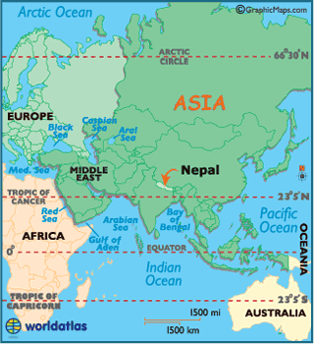
Geographical Location of Nepal

Slide 3


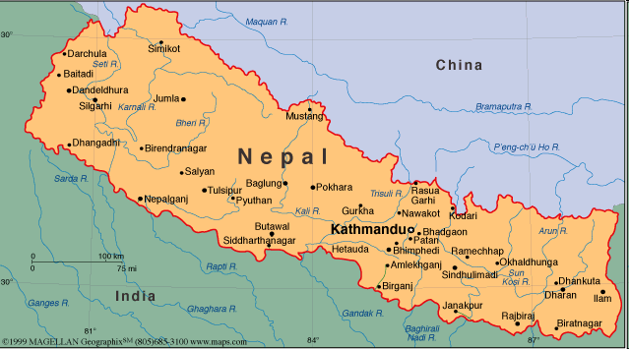

Map of Nepal
3

Slide 4
Why Nepal is more vulnerable to Climate Change impacts?
Nepal as the 4th most vulnerable country worldwide. (The Climate Change Risk Atlas 2010 )
A heavy reliance of the country’s economy on climate-sensitive sectors, coupled with dramatic topography, fragile ecosystems and technical capacity to deal with climatic uncertainties…..

Slide 5
Climate Sensitive Health Risks in Nepal
Vector borne diseases
Diarrheal diseases including cholera
Food-borne diseases
Malnutrition
Cardio-respiratory diseases
Psychological stress
Extreme weather related health effects
Injuries etc.

Slide 6
Problem of climate sensitive disease
Diseases | No. of districts out of 75 district | Population at (%)
Malaria | 65 | 91.6
Lymphatic filariasis | 60 | 87.0
Japanese encephalitis | 24 | 53.9
Kala-azar | 12 | 29.7
Dengue | 24 | 55
Chikungunya | 24 | 55

Slide 7
Climate Change Related Activities
National Workshop on Climate Change and Human Health: Potential Impact, Vulnerability and Adaptation in Nepal (19-21 Dec., 2007). (Initial steps in the area)
Incorporation of Health as a separate component in National Adaptation Program of Action (NAPA) 2010
Role out of the NAPA through local adaptation program of Action (LAPA) 2011

Slide 8
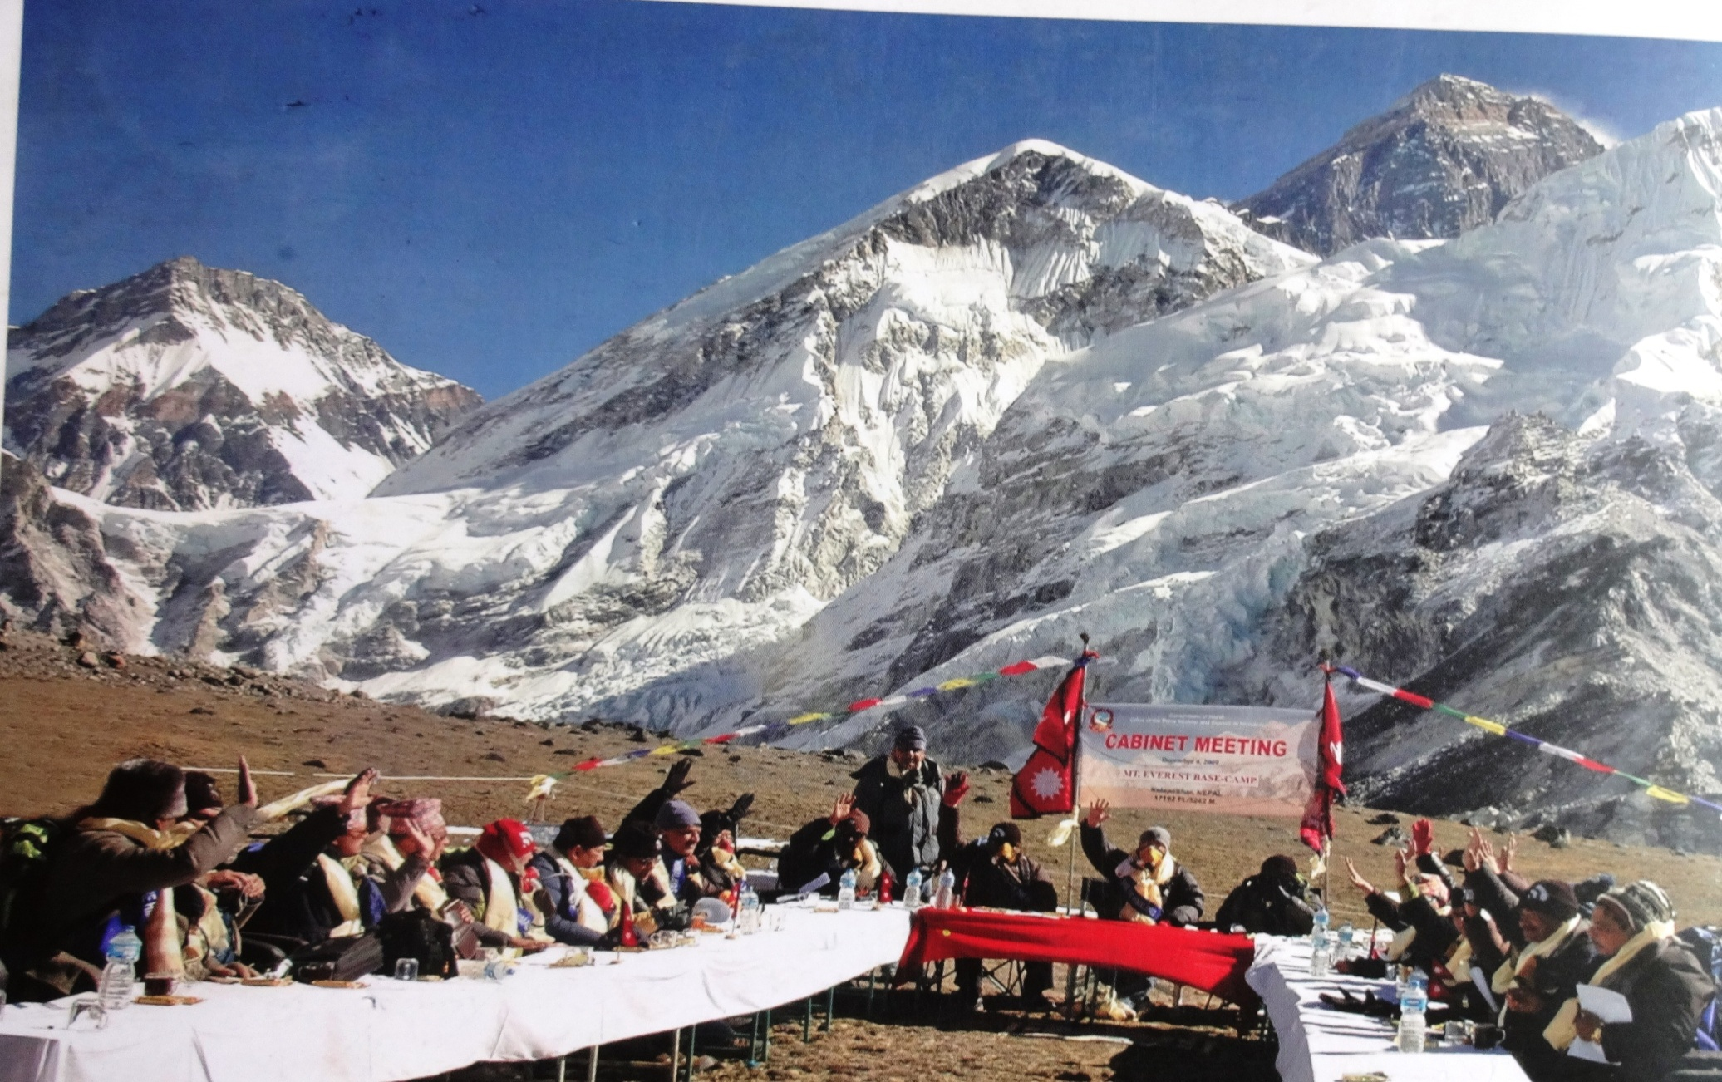
In December 2009, Madhav Kumar Nepal (PM) and the Nepali Cabinet held a cabinet meeting at the base of Kala Patthar (Everest Base Camp) as a solidarity response to impacts of climate change.

Slide 9
Efforts at MoH (Contd….)
Nepal Health Sector Program II (2010-2015)
  Climate change and health – through networks of academia and practitioners on climate change
  WASH – Promoting the behavior change communication strategies and enhancing partnership and collaboration

Slide 10
Policy level efforts
Climate Change Policy 2011 (MoSTE)
  Acknowledged the negative impact of Climate Change on health
  Developing a necessary mechanism for forecasting and preventing vector borne, infectious and communicable diseases induced by climate change

Slide 11
National Health Policy 2014
National Health Policy (NHP) 2014
  Climate change is defined as one of the major health problem.
  Policies (14 policies)
    stresses upon mainstreaming health in all policies
    Ensure healthy environment as a inherent right of citizen.

Slide 12
National Health Policy 2014….
Strategies to be taken (under NHP 2014):
Multi sectoral action plans will be developed and implemented ensuring involvement of all sectors: safe water, sanitation, energy, food safety, climate, environment, education, housing, road.
Proper coordination and cooperation with concerned stakeholders will be done to manage vector borne diseases

Slide 13
Policy level ………
Constitution of Nepal 2015
  right to live in healthy environment
  right to seek basic health care services from the state
  Each citizen shall have the right to access to clean water and hygiene.

Slide 14
Nepal Health Sector Strategy (NHSS)
(2015-2020): Overarching Principles
Universal Health Coverage
Equity
Quality
Multi-sectoral Approach
Reform

Slide 15
NHSS (2015-2020) Contd….
Several Social Determinants of health – proposed to be addressed through multi sectoral approach
  Promoting healthy lifestyles and healthy environment
  Coming together to promote healthy environment
  Establishing multi sectoral response to climate change

Slide 16
Existing Programmes
Inclusion of climate change and health component in regular training of health professionals
Development of IEC/BCC materials on climate change and health
Research study on climate change and diarrheal diseases
DFID project “Building adaptation to climate change in health in LDCs through resilient WASH” (2013-17)

Slide 17
Vulnerability & Adaptation Assessment and
H-NAP
Conducted trainings based on WHO/PAHO Guideline
Under guidance of an international expert, 5 national experts drafted VAA report covering
  Climatology
  Epidemiology
  Health systems strengthening
  WASH
  Disaster
Based on V&A assessment, H-NAP is prepared

Slide 18
Priority Activities
Awareness raising
Evidence generation
Integrated disease Surveillance.
Early warning system
Capacity enhancement

Slide 19
Challenges
Coordination for multi- sectoral response
Resource
  HR
  Financial
Evidence
  Research
  Data
  Information)

Slide 20
Opportunities
Political commitment - climate change is recognized as a national agenda
Climate Change Council, Chaired by Rt. Hon Prime Minster
Eligible to access climate adaption funds
Establishment of Diseases Control, Climate Change and Environment Section at MoH
Institutions for implementation are in place e.g., NHRC (Research), NHTC (Training), NHEIC (IEC/BCC), EDCD( Surveillance and control), NPHL (Laboratory diagnosis), DPHOs (action) etc.

Slide 21

Thank You

