Slide 1
Weather & Climate Data Products & Services
ZMD’s Last Mile Building Blocks:
Edson Nkonde
‘The Last Mile’
Saving lives, improving livelihoods and increasing resiliency with tailored weather information services for a changing climate
Livingstone, Zambia, 15-17 March, 2016

Slide 2
Outline
ZMD Mandate
Observation Station Network
Products & Services
Improving Climate Services & Delivery
Enhancing National ClimaTe Services - ENACTS

Slide 3
ZMD Mandate
Observe and Record Weather and Climate
Analyze the observations to come up with Products & services for different user sectors of the economy
Disseminate the Product and Information
Wx & Climate Data
Products & Services
Content Delivery
All done to protect life, property & ensure sustainable development

Slide 4
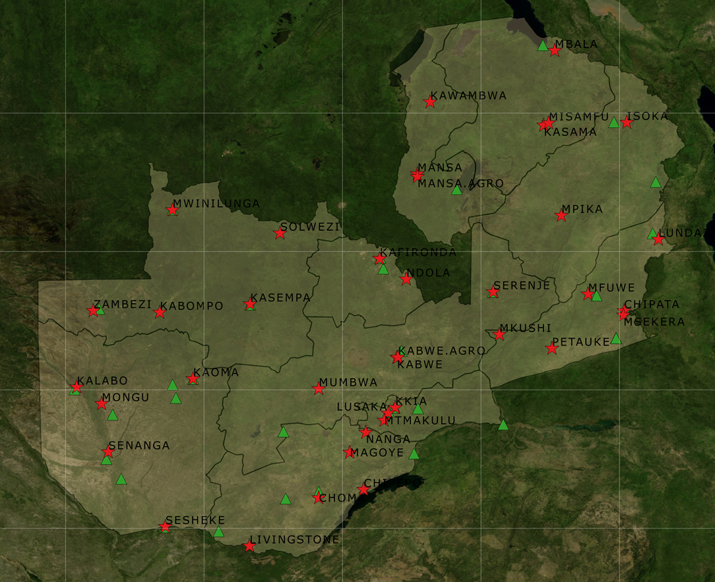
Observation Station Network
39 Manual Stations
38 Installed AWS
28 AWS currently being installed (so far 3 Installed)
Over 50 years of Time-Series data for a Typical Manual Station
Up to 5 years of AWS Data

Slide 5
Products & Services
Seasonal Rainfall Forecast (September)
Crop Weather Bulletins (Every 10 days)
Daily Weather Forecast (2 times /day)
Early Warning Advisories (Flash Flood Guidance System)
Climate Data
Aviation Products & Services (ISO certified)
ENACTS Platform

Slide 6
Improving Service Delivery
CIEWS & SASSCAL
  Improve station network density
  Increase skilled manpower
  Improve dissemination of climate information to users
RANET
  Helping Communities establish Community Radio Stations
  Providing Environmental Information to Communities through Radio
ENACTS (collaboration with IRI-Columbia University)
  Enhancing National ClimaTe Services

Slide 7
ENACTS
ENACTS approach Strives to simultaneously improve availability, access and use of climate data & information.
ENACTS tools help conduct quality-control on all available station data and merged them with satellite and reanalysis products.
ENACTS helps to create reliable climate information products for local decision-making.

Slide 8
ENACTS–What has been done so far
Blended data to overcome observational gaps
Results: Over 30 years of high resolution rainfall and temperature data now available, enabling climate analysis from community to national levels
Online Maprooms
Result: User friendly tools for the analysis, visualization, and downscaling of climate information
Empower stakeholders with increased capacity
Result: Strengthened policy analysis, relevant for multiple sectors
Availability
Access
Built Capacity& Empowerment

Slide 9
ENACTS-Next Steps
Promote Use
  Engage users
  Raise awareness
  Build capacity of users to understand and use climate information
  Involve users in product development

Slide 10
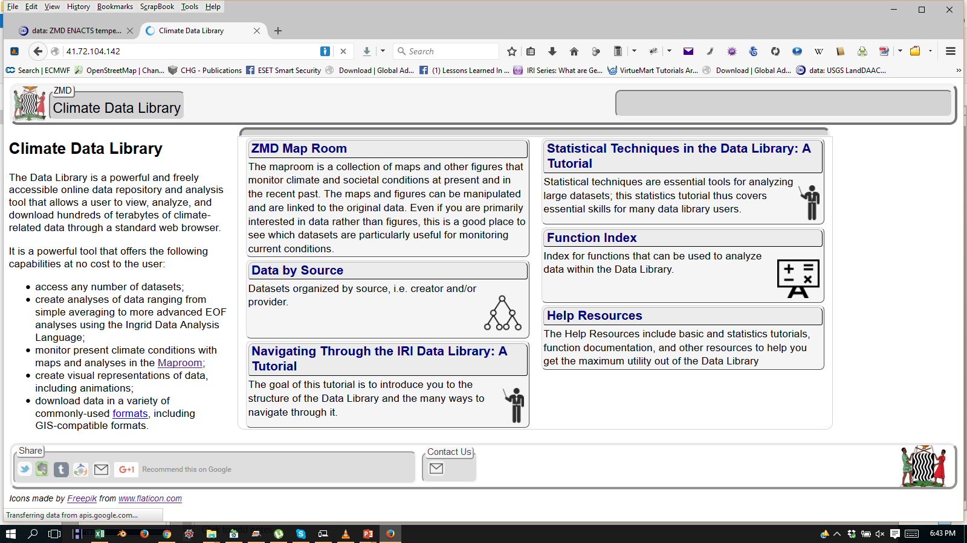
ENACTS Access

Slide 11
Data & Information for the Last Mile
50 years of daily Station Weather and Climate Data
30 years and 50 years of Gridded dataset for rainfall and temperature respectively at 4km resolution
Daily Weather Forecasts
Crop Weather Bulletin
Monthly Weather Review
Seasonal Rainfall Forecasts
ENACTS Platform

