Slide 1
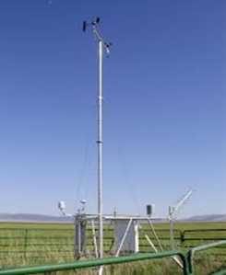
Main Findings of the CIRDA Market Assessment
Revenue-generating opportunities through tailored weather information products
Anthony Mills
CEO C4 EcoSolutions
Cape Town, South Africa
www.c4es.co.za
UNDP CIRDA Country Program Managers Workshop 15-17 March 2016 Livingstone, Zambia

Slide 2
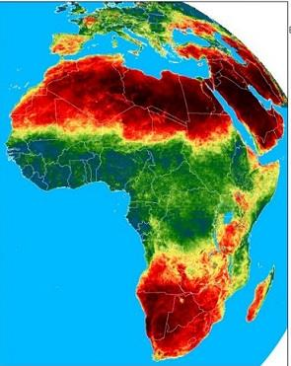
Outline of presentation
Assignment
Main Findings
Conclusions
Notes:
Executive Summary
The availability of timeous, accurate and sufficiently granular weather and climate information is an urgent priority by African countries for them to adapt effectively to the negative effects of climate change. These effects include greater frequencies and intensities of droughts and floods, major shifts in the growing season of crops, and increases in the frequency and severity of hazardous local weather events such as severe thunderstorms. National Meteorological and Hydrological Services (NMHSs) are well-positioned to play a leading role in providing this information.
In most African countries, the NHMSs do not have sufficient resources to provide the timeous, accurate and tailored weather and climate information products (also known as “climate information (CI) and early warning (EW) services”) required by stakeholders as diverse as private sector businesses, government departments, urban dwellers, and smallholder farmers. Such stakeholders are increasingly turning to private weather companies that operate globally and tailor their products from satellite data as well as historical weather data

Slide 3
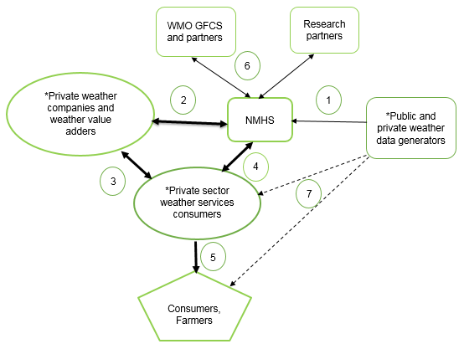
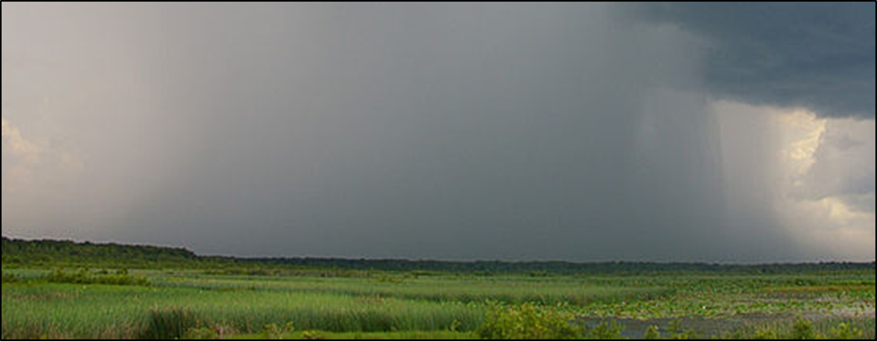
Assignment
Continental-scale market assessment of opportunities for developing tailored weather and climate products.
Assess the readiness of the 11 NHMSs in countries supported by CIRDA to pursue commercialisation of weather and climate services.
Identify potential pathways for such commercialisation.

Slide 4
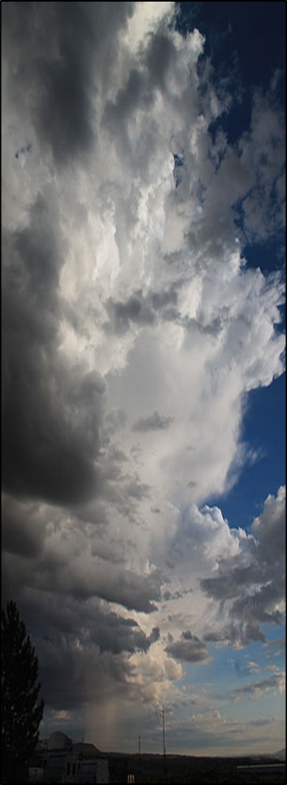
Assignment: methods
Desktop research
Interviews:
NHMSs
private companies
UN agencies
NGOs
research institutions
Sectors/themes:
agriculture
aviation
energy
forestry
insurance
mining
water
Notes:
Executive Summary
The availability of timeous, accurate and sufficiently granular weather and climate information is an urgent priority by African countries for them to adapt effectively to the negative effects of climate change. These effects include greater frequencies and intensities of droughts and floods, major shifts in the growing season of crops, and increases in the frequency and severity of hazardous local weather events such as severe thunderstorms. National Meteorological and Hydrological Services (NMHSs) are well-positioned to play a leading role in providing this information.
In most African countries, the NHMSs do not have sufficient resources to provide the timeous, accurate and tailored weather and climate information products (also known as “climate information (CI) and early warning (EW) services”) required by stakeholders as diverse as private sector businesses, government departments, urban dwellers, and smallholder farmers. Such stakeholders are increasingly turning to private weather companies that operate globally and tailor their products from satellite data as well as historical weather data

Slide 5
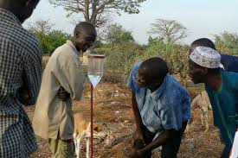
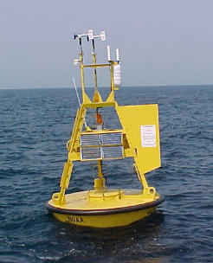
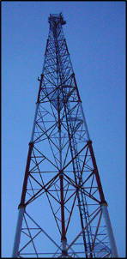
Main Findings
Availability, diversity, sophistication and use of weather information
National weather markets
Use of satellite data
Private weather companies
Notes:
Executive Summary
The availability of timeous, accurate and sufficiently granular weather and climate information is an urgent priority by African countries for them to adapt effectively to the negative effects of climate change. These effects include greater frequencies and intensities of droughts and floods, major shifts in the growing season of crops, and increases in the frequency and severity of hazardous local weather events such as severe thunderstorms. National Meteorological and Hydrological Services (NMHSs) are well-positioned to play a leading role in providing this information.
In most African countries, the NHMSs do not have sufficient resources to provide the timeous, accurate and tailored weather and climate information products (also known as “climate information (CI) and early warning (EW) services”) required by stakeholders as diverse as private sector businesses, government departments, urban dwellers, and smallholder farmers. Such stakeholders are increasingly turning to private weather companies that operate globally and tailor their products from satellite data as well as historical weather data

Slide 6
Private weather companies not dependent on NHMS data
Considerable risk of private sector dominating and NHMSs being marginalised.

Slide 7
Accurate, consistent data from observation networks:
quality of weather information products
size of weather market
sharing of revenue streams

Slide 8
Pertinent quotes from interviews
InfoPlaza: Dutch company that split off from NHMS
“Developing a market for weather products is difficult …The effort required to create innovative products and develop the business should not be underestimated.”
“For the CIRDA programme, it is important to keep in mind the end‑goal. Is the NHMS being developed? Is the market for weather products being developed? Are both the NHMS and market for weather products being developed?”
Notes:
Executive Summary
The availability of timeous, accurate and sufficiently granular weather and climate information is an urgent priority by African countries for them to adapt effectively to the negative effects of climate change. These effects include greater frequencies and intensities of droughts and floods, major shifts in the growing season of crops, and increases in the frequency and severity of hazardous local weather events such as severe thunderstorms. National Meteorological and Hydrological Services (NMHSs) are well-positioned to play a leading role in providing this information.
In most African countries, the NHMSs do not have sufficient resources to provide the timeous, accurate and tailored weather and climate information products (also known as “climate information (CI) and early warning (EW) services”) required by stakeholders as diverse as private sector businesses, government departments, urban dwellers, and smallholder farmers. Such stakeholders are increasingly turning to private weather companies that operate globally and tailor their products from satellite data as well as historical weather data

Slide 9
Pertinent quotes from interviews
Anonymous:
“..there is a big difference in the information that Accuweather provides and the data that the NHMS provides. In most countries in Africa, Accuweather provide more accurate information than the NHMS.”
Notes:
Executive Summary
The availability of timeous, accurate and sufficiently granular weather and climate information is an urgent priority by African countries for them to adapt effectively to the negative effects of climate change. These effects include greater frequencies and intensities of droughts and floods, major shifts in the growing season of crops, and increases in the frequency and severity of hazardous local weather events such as severe thunderstorms. National Meteorological and Hydrological Services (NMHSs) are well-positioned to play a leading role in providing this information.
In most African countries, the NHMSs do not have sufficient resources to provide the timeous, accurate and tailored weather and climate information products (also known as “climate information (CI) and early warning (EW) services”) required by stakeholders as diverse as private sector businesses, government departments, urban dwellers, and smallholder farmers. Such stakeholders are increasingly turning to private weather companies that operate globally and tailor their products from satellite data as well as historical weather data

Slide 10
Pertinent quotes from interviews
Meteogroup: Dutch weather company; combine data from numerous sources to provide reliable and detailed weather forecasts; 140 forecasters on their staff.
“In the 1990s [in Europe], competition between NHMSs and private weather companies was pervasive. Currently, however, NHMSs make their data readily available.”
“[Meteogroup]…pays a standard, fixed price for the data – which is often 11% of the revenue ...”
“Raw weather data in isolation has limited value. Rather value is generated from weather data through the development of services. The precise value of these services is determined by data reliability and …incomes. The challenge for NHMSs in African countries is to make their data available.”
Anonymous: “The majority of NHMSs … are focused on owning the data instead of improving the availability of these data.”
Notes:
Executive Summary
The availability of timeous, accurate and sufficiently granular weather and climate information is an urgent priority by African countries for them to adapt effectively to the negative effects of climate change. These effects include greater frequencies and intensities of droughts and floods, major shifts in the growing season of crops, and increases in the frequency and severity of hazardous local weather events such as severe thunderstorms. National Meteorological and Hydrological Services (NMHSs) are well-positioned to play a leading role in providing this information.
In most African countries, the NHMSs do not have sufficient resources to provide the timeous, accurate and tailored weather and climate information products (also known as “climate information (CI) and early warning (EW) services”) required by stakeholders as diverse as private sector businesses, government departments, urban dwellers, and smallholder farmers. Such stakeholders are increasingly turning to private weather companies that operate globally and tailor their products from satellite data as well as historical weather data

Slide 11
Pertinent quotes from interviews
Anonymous private weather company:
“…has direct supply agreements with many NHMSs worldwide …purchases weather stations …can access unrestricted data… increases the value of the data by packaging it and selling these packages to end users.”
On one NHMS: “…staff within the NHMS do not understand the market value of weather data and either underprice or overprice these data; ii) the NHMS collects and stores weather data but not in an appropriate format for users, such as excel spreadsheets; and iii) the quality of weather data is limited.”
“It would be ideal if [weather company] partners with NHMSs in Africa to assist them with adding value to their data.”
[Weather company could] “…act as an intermediary for private sector companies wishing to access weather information from [country x]… Instead of 20 companies contacting the NHMS, [weather company] can act on behalf of these 20 companies to streamline the information sharing process.
Notes:
Executive Summary
The availability of timeous, accurate and sufficiently granular weather and climate information is an urgent priority by African countries for them to adapt effectively to the negative effects of climate change. These effects include greater frequencies and intensities of droughts and floods, major shifts in the growing season of crops, and increases in the frequency and severity of hazardous local weather events such as severe thunderstorms. National Meteorological and Hydrological Services (NMHSs) are well-positioned to play a leading role in providing this information.
In most African countries, the NHMSs do not have sufficient resources to provide the timeous, accurate and tailored weather and climate information products (also known as “climate information (CI) and early warning (EW) services”) required by stakeholders as diverse as private sector businesses, government departments, urban dwellers, and smallholder farmers. Such stakeholders are increasingly turning to private weather companies that operate globally and tailor their products from satellite data as well as historical weather data

Slide 12
Pertinent quotes from interviews
Meteogroup:
What factors are needed for Meteogroup to start working in Africa?
political stability;
favourable legislative and regulatory frameworks;
an NHMS that has a basic operating observation network with adequate reliability;
industries with a strong dependence on weather information;
a reliable means of communication with farmers; and
adequate levels of education in end users, particularly with regards to weather information.
Notes:
Executive Summary
The availability of timeous, accurate and sufficiently granular weather and climate information is an urgent priority by African countries for them to adapt effectively to the negative effects of climate change. These effects include greater frequencies and intensities of droughts and floods, major shifts in the growing season of crops, and increases in the frequency and severity of hazardous local weather events such as severe thunderstorms. National Meteorological and Hydrological Services (NMHSs) are well-positioned to play a leading role in providing this information.
In most African countries, the NHMSs do not have sufficient resources to provide the timeous, accurate and tailored weather and climate information products (also known as “climate information (CI) and early warning (EW) services”) required by stakeholders as diverse as private sector businesses, government departments, urban dwellers, and smallholder farmers. Such stakeholders are increasingly turning to private weather companies that operate globally and tailor their products from satellite data as well as historical weather data

Slide 13
Pertinent quotes from interviews
Meteogroup:
Did Meteogroup outcompete the NHMS in [country x]…?
“No, the basic infrastructure provided and maintained by the NHMS was of value to Meteogroup. Therefore, cooperation with the NHMS was promoted, rather than competition – an approach followed by Meteogroup in all countries where it is active.”
Notes:
Executive Summary
The availability of timeous, accurate and sufficiently granular weather and climate information is an urgent priority by African countries for them to adapt effectively to the negative effects of climate change. These effects include greater frequencies and intensities of droughts and floods, major shifts in the growing season of crops, and increases in the frequency and severity of hazardous local weather events such as severe thunderstorms. National Meteorological and Hydrological Services (NMHSs) are well-positioned to play a leading role in providing this information.
In most African countries, the NHMSs do not have sufficient resources to provide the timeous, accurate and tailored weather and climate information products (also known as “climate information (CI) and early warning (EW) services”) required by stakeholders as diverse as private sector businesses, government departments, urban dwellers, and smallholder farmers. Such stakeholders are increasingly turning to private weather companies that operate globally and tailor their products from satellite data as well as historical weather data

Slide 14
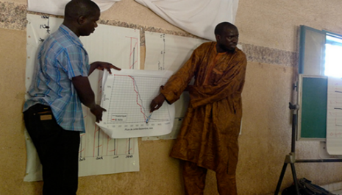
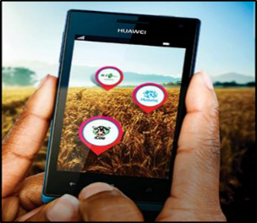
Market Assessment Conclusions
NHMSs should partner with rather than compete with private sector weather companies.
NHMSs should embark on phased, slow transitions into entities that derive benefits from the national private weather markets.
Notes:
Executive Summary
The availability of timeous, accurate and sufficiently granular weather and climate information is an urgent priority by African countries for them to adapt effectively to the negative effects of climate change. These effects include greater frequencies and intensities of droughts and floods, major shifts in the growing season of crops, and increases in the frequency and severity of hazardous local weather events such as severe thunderstorms. National Meteorological and Hydrological Services (NMHSs) are well-positioned to play a leading role in providing this information.
In most African countries, the NHMSs do not have sufficient resources to provide the timeous, accurate and tailored weather and climate information products (also known as “climate information (CI) and early warning (EW) services”) required by stakeholders as diverse as private sector businesses, government departments, urban dwellers, and smallholder farmers. Such stakeholders are increasingly turning to private weather companies that operate globally and tailor their products from satellite data as well as historical weather data

Slide 15
Conclusions: partnering
NHMSs
Primary weather information
Local scale weather phenomena
Regulatory environment
Guardian of national data
Trusted intermediary
Protecting public good
Weather companies
Satellite data
Product development
Innovation
Niche products
Marketing
Sales
Partnership principles: competitive, non-exclusive and performance-based.
Lessons learned from Netherlands, USA and South Africa
Notes:
Executive Summary
The availability of timeous, accurate and sufficiently granular weather and climate information is an urgent priority by African countries for them to adapt effectively to the negative effects of climate change. These effects include greater frequencies and intensities of droughts and floods, major shifts in the growing season of crops, and increases in the frequency and severity of hazardous local weather events such as severe thunderstorms. National Meteorological and Hydrological Services (NMHSs) are well-positioned to play a leading role in providing this information.
In most African countries, the NHMSs do not have sufficient resources to provide the timeous, accurate and tailored weather and climate information products (also known as “climate information (CI) and early warning (EW) services”) required by stakeholders as diverse as private sector businesses, government departments, urban dwellers, and smallholder farmers. Such stakeholders are increasingly turning to private weather companies that operate globally and tailor their products from satellite data as well as historical weather data

Slide 16
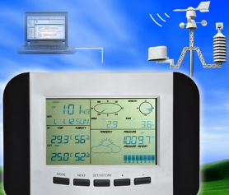
Conclusions: partnering
Considerable interest from private sector to engage with (even invest in) NHMSs
Companies specialising in data acquisition identified as ideal partners
Cultural shift towards entrepreneurial mind-set can take 10+ years (New Zealand experience)
New skills sets (business development, negotiation skills etc.) required
Notes:
Executive Summary
The availability of timeous, accurate and sufficiently granular weather and climate information is an urgent priority by African countries for them to adapt effectively to the negative effects of climate change. These effects include greater frequencies and intensities of droughts and floods, major shifts in the growing season of crops, and increases in the frequency and severity of hazardous local weather events such as severe thunderstorms. National Meteorological and Hydrological Services (NMHSs) are well-positioned to play a leading role in providing this information.
In most African countries, the NHMSs do not have sufficient resources to provide the timeous, accurate and tailored weather and climate information products (also known as “climate information (CI) and early warning (EW) services”) required by stakeholders as diverse as private sector businesses, government departments, urban dwellers, and smallholder farmers. Such stakeholders are increasingly turning to private weather companies that operate globally and tailor their products from satellite data as well as historical weather data

Slide 17
Conclusions: partnering
NHMS status
Revenue sharing
Gov. funding
Improved products
Weather market
Accurate, consistent data from NHMS
Policies and regulations that promote data sharing
Virtuous cycle:
underpinned by strong NHMS
Society aware of socio-economic benefits of strong NHMS
Expanding ground observation network
Notes:
Executive Summary
The availability of timeous, accurate and sufficiently granular weather and climate information is an urgent priority by African countries for them to adapt effectively to the negative effects of climate change. These effects include greater frequencies and intensities of droughts and floods, major shifts in the growing season of crops, and increases in the frequency and severity of hazardous local weather events such as severe thunderstorms. National Meteorological and Hydrological Services (NMHSs) are well-positioned to play a leading role in providing this information.
In most African countries, the NHMSs do not have sufficient resources to provide the timeous, accurate and tailored weather and climate information products (also known as “climate information (CI) and early warning (EW) services”) required by stakeholders as diverse as private sector businesses, government departments, urban dwellers, and smallholder farmers. Such stakeholders are increasingly turning to private weather companies that operate globally and tailor their products from satellite data as well as historical weather data

Slide 18
Conclusions: phased transition
3 main groups emerged across countries in the CIRDA programme:
Ready to engage with selected private sector companies: Tanzania, Zambia and Burkina Faso
Moderate capacity building required before extensive engagement with the private sector: Benin, Ethiopia, the Gambia, Malawi and Uganda and
Intensive capacity building required before extensive engagement with the private sector: Liberia, Sao Tome and Principe, and Sierra Leone
Notes:
Executive Summary
The availability of timeous, accurate and sufficiently granular weather and climate information is an urgent priority by African countries for them to adapt effectively to the negative effects of climate change. These effects include greater frequencies and intensities of droughts and floods, major shifts in the growing season of crops, and increases in the frequency and severity of hazardous local weather events such as severe thunderstorms. National Meteorological and Hydrological Services (NMHSs) are well-positioned to play a leading role in providing this information.
In most African countries, the NHMSs do not have sufficient resources to provide the timeous, accurate and tailored weather and climate information products (also known as “climate information (CI) and early warning (EW) services”) required by stakeholders as diverse as private sector businesses, government departments, urban dwellers, and smallholder farmers. Such stakeholders are increasingly turning to private weather companies that operate globally and tailor their products from satellite data as well as historical weather data

Slide 19
Conclusions: phased transition
Virtuous cycle activities
Cost-benefit ratios of 1:4 in Europe to 1:10 in Central Asia
Raise awareness of socio-economic benefits (productivity & losses)
Engage treasury
Revise regulations to promote partnerships and data sharing
Define roles of private sector versus NHMS (manage expectations)
Expand ground observation network (potentially on cell phone towers)
Accurate data
Regulations
Data sharing
Observation network
Market
Notes:
Executive Summary
The availability of timeous, accurate and sufficiently granular weather and climate information is an urgent priority by African countries for them to adapt effectively to the negative effects of climate change. These effects include greater frequencies and intensities of droughts and floods, major shifts in the growing season of crops, and increases in the frequency and severity of hazardous local weather events such as severe thunderstorms. National Meteorological and Hydrological Services (NMHSs) are well-positioned to play a leading role in providing this information.
In most African countries, the NHMSs do not have sufficient resources to provide the timeous, accurate and tailored weather and climate information products (also known as “climate information (CI) and early warning (EW) services”) required by stakeholders as diverse as private sector businesses, government departments, urban dwellers, and smallholder farmers. Such stakeholders are increasingly turning to private weather companies that operate globally and tailor their products from satellite data as well as historical weather data

Slide 20
Conclusions: phased transition
Potential partnerships/activities
Mobile phone companies
Weather companies providing primary weather data
Expanded relationships in aviation sector
Developing tailored weather information products within partnerships
Weather index-based insurance products (acknowledging great complexity)
Financial services (hedging against power disruptions)
Operation of weather stations
Sectors:
Health
Water
Agriculture
Tourism
Mining
Energy
Forestry
Fisheries
Disaster management
Infrastructure
Transport
Notes:
Executive Summary
The availability of timeous, accurate and sufficiently granular weather and climate information is an urgent priority by African countries for them to adapt effectively to the negative effects of climate change. These effects include greater frequencies and intensities of droughts and floods, major shifts in the growing season of crops, and increases in the frequency and severity of hazardous local weather events such as severe thunderstorms. National Meteorological and Hydrological Services (NMHSs) are well-positioned to play a leading role in providing this information.
In most African countries, the NHMSs do not have sufficient resources to provide the timeous, accurate and tailored weather and climate information products (also known as “climate information (CI) and early warning (EW) services”) required by stakeholders as diverse as private sector businesses, government departments, urban dwellers, and smallholder farmers. Such stakeholders are increasingly turning to private weather companies that operate globally and tailor their products from satellite data as well as historical weather data

Slide 21
Conclusions: phased transition
Engaging with private sector to forge deals
Use service providers to bridge the gap (business development, sales and marketing)
Develop in-house expertise
Identify suitable entry points through in-depth national market assessments (e.g. primary weather data providers)
Notes:
Executive Summary
The availability of timeous, accurate and sufficiently granular weather and climate information is an urgent priority by African countries for them to adapt effectively to the negative effects of climate change. These effects include greater frequencies and intensities of droughts and floods, major shifts in the growing season of crops, and increases in the frequency and severity of hazardous local weather events such as severe thunderstorms. National Meteorological and Hydrological Services (NMHSs) are well-positioned to play a leading role in providing this information.
In most African countries, the NHMSs do not have sufficient resources to provide the timeous, accurate and tailored weather and climate information products (also known as “climate information (CI) and early warning (EW) services”) required by stakeholders as diverse as private sector businesses, government departments, urban dwellers, and smallholder farmers. Such stakeholders are increasingly turning to private weather companies that operate globally and tailor their products from satellite data as well as historical weather data

Slide 22
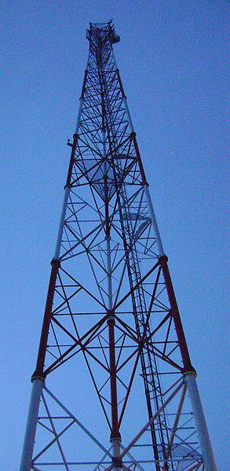
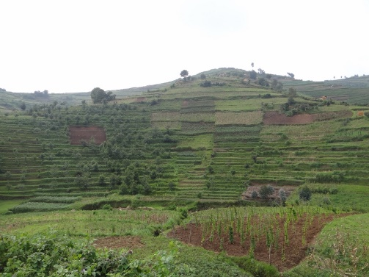
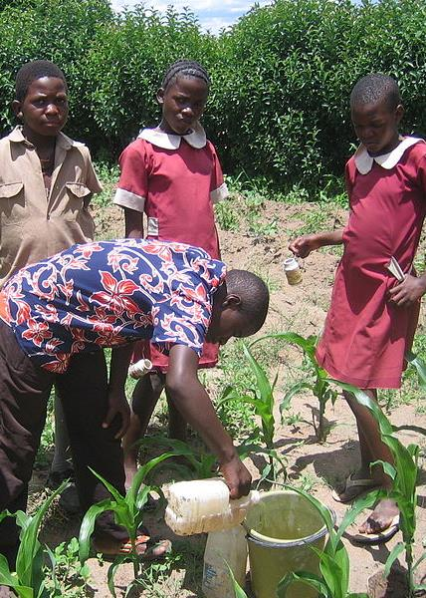
End of presentation
Thank you for your attention

