Slide 1
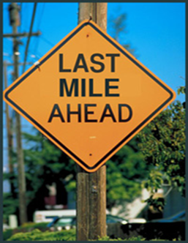
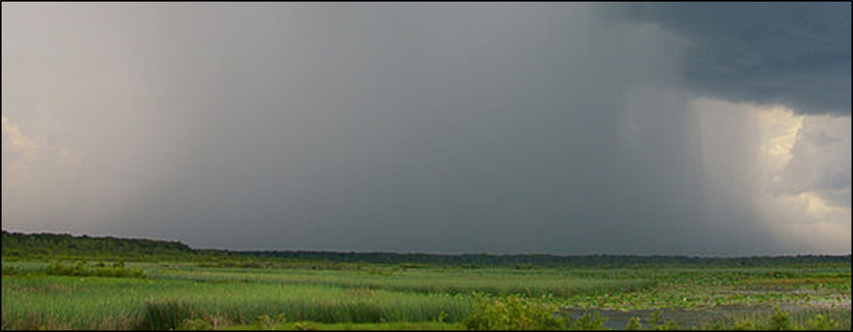
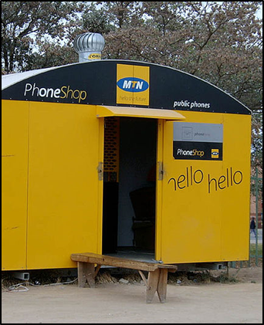
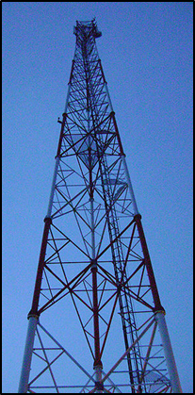
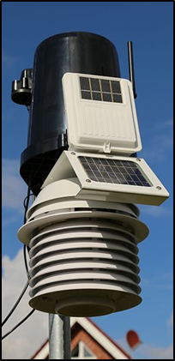


Challenges, opportunities and successes
in crossing the Last Mile:
delivering climate services in Africa
  Anthony Mills, CEO C4 EcoSolutions
  Cape Town, South Africa
  www.c4es.co.za
  UNDP-CIRDA Country Partner Project Manager Workshop, 25–27 August 2015, Addis Ababa,
  Ethiopia.

Slide 2

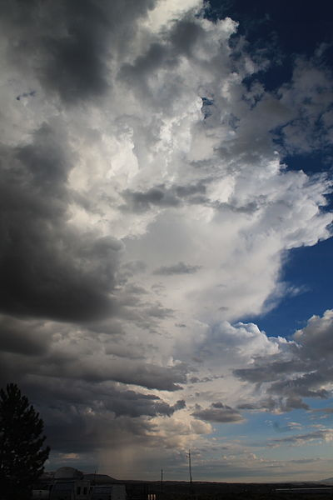

Overview of presentation
Intricacies and complexity of the Last Mile
  Weaving ways across the Last Mile
  Learning from other sectors (retail, health, adaptation)
  Concluding remarks

Slide 3

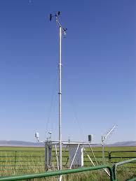
Intricacies and complexity:
Conceptual Framework
Public Based Organisations
Government
Private sector
Other weather data generators
AfricaWeather
EARS
NGOs and research institutions
NOAA
EUMETSAT
Private weather companies/value adders
CGIAR
USAID
IRI
UN agencies
GFCS
ACMAD
AGRYMET
NHMS
EcoNet
Pilotfriend
Diverse users:
Rural farmers
Air flight controllers
Farmers, businesses, pastoralists
Private sector climate services consumers
Notes:
Providing the bigger picture of the main stakeholders around the generation, provision and consumption of weather information.
Important to understand the context and the relationships between the stakeholders. Why do certain relationships exist and how are they maintained? This helps to get an idea of what conditions need to be in place for optimal operation of the NHMS.
CGIAR: Consultative Group for International Agricultural Research
IRI: International Research Institute (for climate research)
GFCS: Global Framework for Climate Services
ACMAD: African Centre of Meteorological Applications and Development
AGRHYMET: AGRiculture HYdrology and METerology
WASCAL: West African Science Service Centre on Climate Change and Land Use

Slide 4
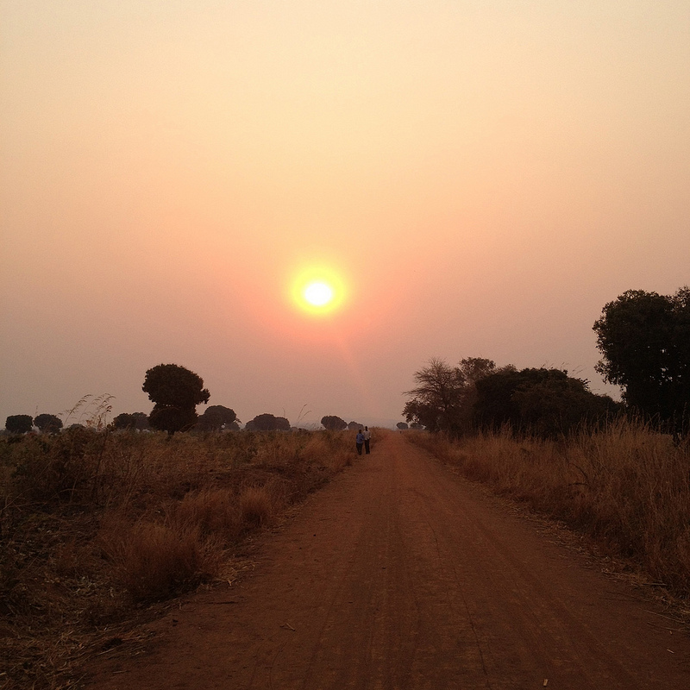
National Hydro- Meteorological Services
Communicators and boundary organizations (e.g. media, agricultural extension, NGOs, CBOs, private sector)
End users (e.g. farmers, pastoralists)
National Agricultural Research and Extension
National-level end users (e.g. private sector, industry, seed distributors, policy makers)
Institutions
Individuals
Notes:
Important to highlight that this is not a problem unique to climate service/information provision. This is a problem which ALL sectors face. Therefore, it is important to draw on successful case studies/lessons learnt from ALL sectors.

Slide 5
Worthy of deep contemplation:
95% of Africa’s farmers rely on rain
This rain is becoming more erratic as a result of climate change

Slide 6
Climate Services Value Chain
Data
Information
Products and packaging
Fulfillment
Accuracy
Quality of equipment
Needs of user
Skills to interpret data
Tailoring of information
Value adders
Few words
High impact information
Closing the deal
Cost recovery mechanisms
Notes:
This is the value chain the NHMS needs to follow to receive fulfillment.
Data: do we receive sufficient data to make accurate forecasts? Do we have adequate quality of equipment (p.e AWS) to generate data?
Information: Do we know what information the private sector - weather information users - needs? Do we have the skills to interpret and work with the data received?
Products and packaging: Are we capable to package the required information into a tailored product and sell this product? Is the political environment enabling the sales of such products and services?
4. Fulfillment: Are we closing the deal to the advantage of *all* not just the user. Cost Recovery? Fixed fees for inputs or royalty sharing, based on revenue / turnover targets?

Slide 7

Intricacies and complexity
Data
Quantity and quality of data available for distribution?
Capacity to process the data?
Capacity of users to respond appropriately?
Do users trust the information?
Information
Products and packaging
Trust (fulfilment)
Notes:
Isolating language transmission: The information Is delivered in English, which most farmers do not understand. It also contains technical language that is translated differently by various communicators.
**NB mentioned that these steps indicate that there are structural problems in the value chain evident here.

Slide 8
Data
Worthy of contemplation
Multi-disciplinary teams are needed:
“…team of agronomists, soil scientists, plant pathologists, and entomologists.
Information
Products and packaging
Trust (fulfilment)

Slide 9
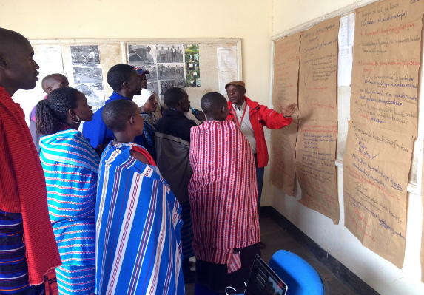
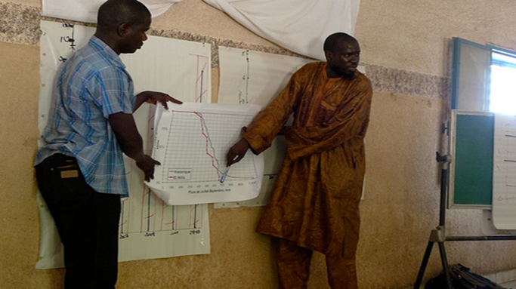
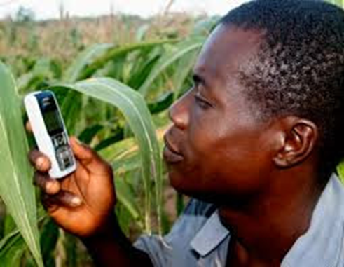
Intricacies and complexity: channels
  Traditional
  Television, radio and print media
  Retail (e.g. supermarkets)
  Face-to-face (e.g. church groups, extension workers, fellow farmers)
  Non-traditional
    Mobile phones (SMS, voice messages)
    Social media (Whatsapp, Twitter and Facebook)

Slide 10
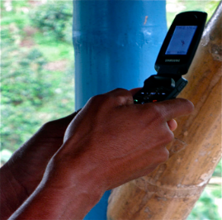

Intricacies and complexity: mobile phones
Mobile network coverage in rural areas?
Ownership of phones (~58%)
Access to smart phones? (~12%)
Translation of SMSs and voice messages?
Literacy? (~60%)
Affordability? (phone as well as data)

Slide 11
Weaving ways across the Last Mile
Study the local context (e.g. cultural norms, women’s vs men’s preferences)
Piggyback on existing networks and infrastructure wherever possible.
Access public funds at the outset. (Jury still out whether last mile can be fully commercial)
Engage with users regularly
Iterate like Coke
Bundle with other services (e.g. loans, insurance, market information, agri extension)
Look for virtuous cycles of value, trust, ease of access

Slide 12
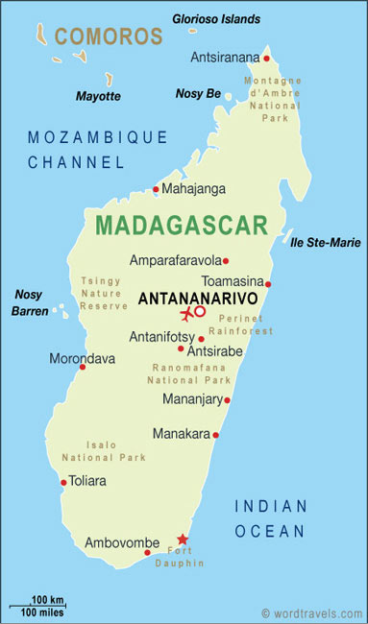
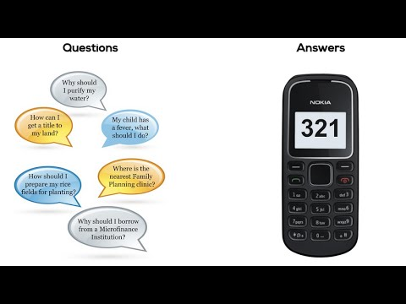
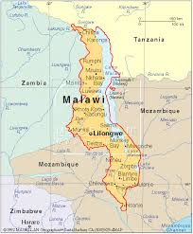
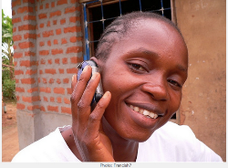
Human Network International's
Service 3-2-1
Land tenure
Early warnings
Health
Agriculture
Family planning
Microfinance

Slide 13
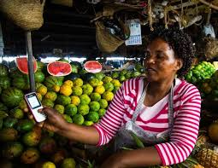
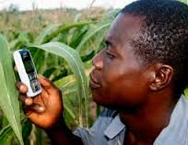

Human Network International's
Service 3-2-1
No internet/data required
Free voice service
~ 3 million subscribers
Service accessed ~50 million times
Public funds
Piggybacked on Airtel
Virtuous cycles of value and trust

Slide 14
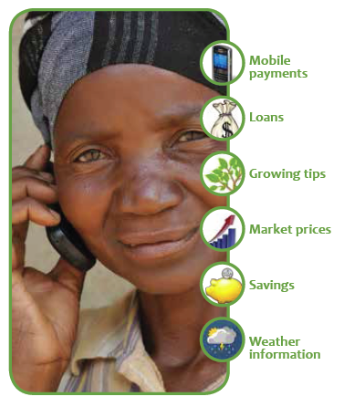
Mercy Corps Agri-Fin Mobile program
Zimbabwe, Uganda and Indonesia
SMS/voice services
100,000 farmers
Banks, mobile network operators, smallholder farmer aggregators
Villagers preferred face to face, TV and radio
Intense training on use of mobile phones
Bundling
Local context
Engagement
Virtuous cycles
Public funds
Piggybacking
Notes:
The Mercy Corps Agri-Fin mobile program provides a “bundle” of advisory and financial services plus market information to the smallholder farmer via the mobile phone.

Slide 15
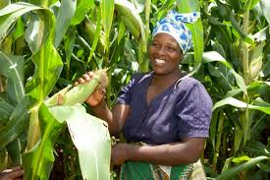
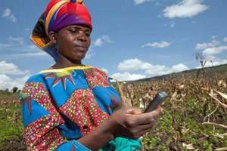
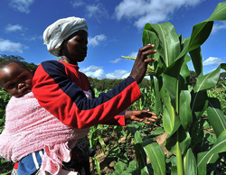
Ecofarmer (Econet, Zimbabwe)
Agri-Fin Mobile partnership with Econet
SMSs: market prices, crop data, weather information
200,000 farmers
60% changing behaviour
Automatic weather stations on mobile phone towers
Uses data for weather-index based insurance
Location of farmers determined from cell phone tower data
>1000 farmers signed up (2014)
Bundling
Virtuous cycles
Public funds
Piggybacking
Notes:
The

Slide 16
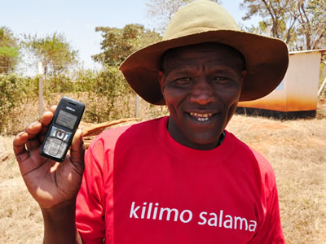
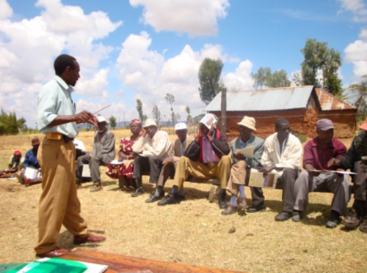
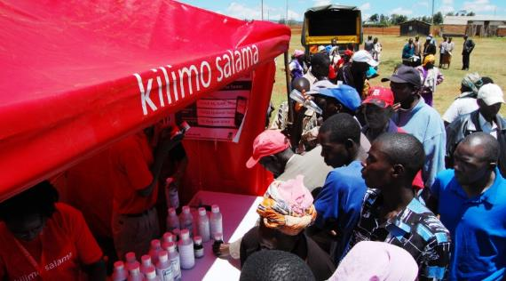
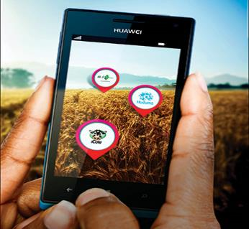
Kilimo Salama (Kenya)
Syngenta Foundation for Sustainable Agriculture (SFSA)
Safaricom and UAP Insurance
Weather index-based insurance
MPESA platform – ease of payouts
Syngenta store network
Local trainers
Insurance with seed purchase
Bundling
Virtuous cycles
Public funds
Piggybacking
Engagement

Slide 17
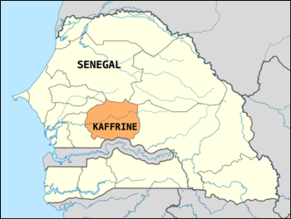
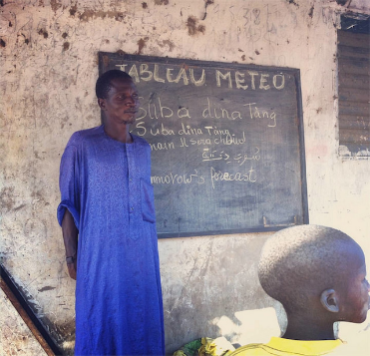
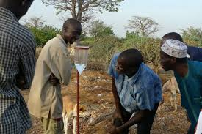
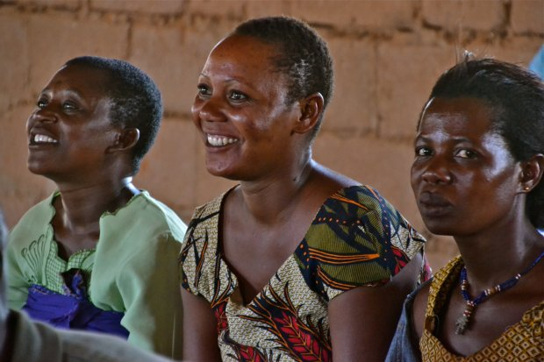

Research in Kaffrine Region, Senegal
CGIAR and CCAF (2011–2012)
3 farmer communities targeted
Provided forecasts and agri-met information
Intensive training and engagement
SMSs in several languages
Red Cross staff trained
Messages posted on boards at communal meeting points (e.g. boreholes)
Bundling
Virtuous cycles
Public funds
Engagement
Local context
Iteration
Notes:
Important to highlight here that through these workshops and the two way dialogue established between forecasters and farmers on forecasting probabilities and farmers needs: i) trust was established, which was critical for the projects’ long term success; and ii) allowed farmers to gain familiarity with seasonal forecasts and weather advisories they has previously not accessed/been exposed to.

Slide 18
Worthy of deep contemplation:
Senegal
Context changed at 10 km intervals!
One village wanted messages in a mosque, another at boreholes
Women planted later than men
Women planted different crops (millet vs maize)
Men owned the donkeys/horses needed for ploughing
Women needed weather information on ‘end’ not start of rains
Tanzania GFCS study
Men wanted radio presenters trained
Women wanted extension officers and village leaders trained

Slide 19


Orange Senekela (Mali)
Collaboration with IER, IICD and RONGEAD
Services via SMS and call centre
Crop varieties
Land preparation
Pest management
Post-harvest information
Market prices
Obstacles
Cost of SMSs and calls
Marketing
Network coverage
Women wanted information on livestock, fisheries, agro-forestry and wildfruits
Bundling
Virtuous cycles
Public funds
Piggybacking
Local context
Engagement
Notes:
Orange Sènèkèla, an agricultural information service, was launched in Mali in July 2013. It is made up of a call centre staffed by agricultural experts and a USSD component delivering market prices.
Content is available for the following topics: • Planning stage: crop varieties, where in the agro-climatic zone to grow the crop, expected yield • Growing stage: from land preparation to harvest • Risks: e.g. illnesses, parasites and how to solve them • Post-harvest: how to store the crop
All the information delivered through the call centre comes from a database developed by IER specifically for Sènèkèla.
call-center which is accessible through the 37 333 from an Orange SIM card in Mali, cost : 50 FCFA/minute
Project encountered issues, wasn’t a complete failure, but did encounter problems

Slide 20
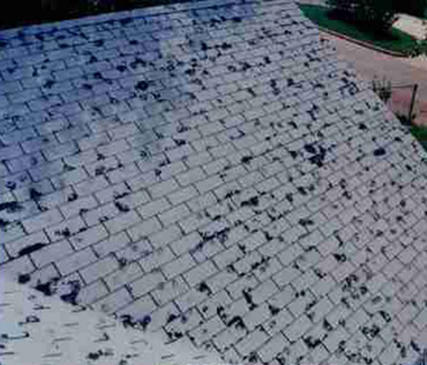

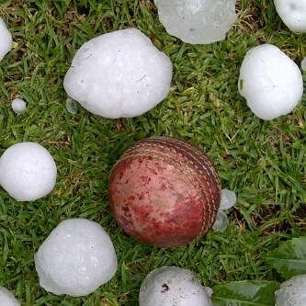

Weather alerts by insurance companies
South African insurance companies
Large customer databases (location, assets)
Tailored SMSs to reduce hail and fire damage.
Bundling
Virtuous cycles
Public funds
Piggybacking
Local context
Engagement
Solely cost reduction

Slide 21
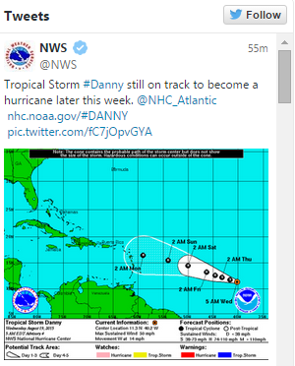
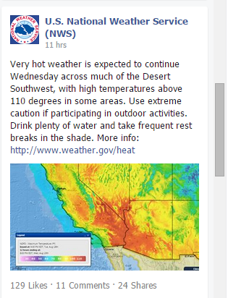

Social media
Facebook and Twitter
Virtuous cycles
Local context
Notes:
Highlight that Firm case studies from Africa lacking, although much anecdotal evidence exists. Social structure enabled and supported through digital me
Can mention the political Arab spring and use of whatapp for political mobilisation in Zim.

Slide 22

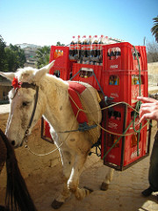
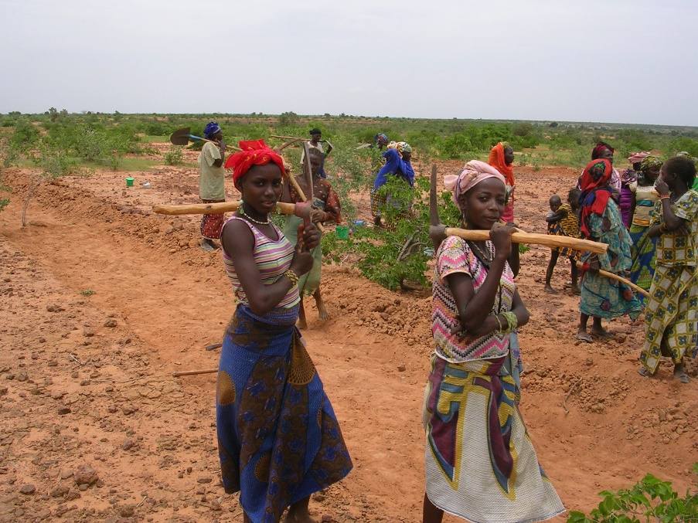
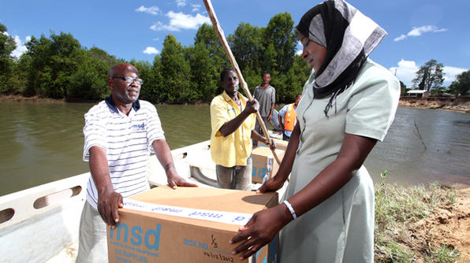
Learning from other sectors
Same problems
Disproportionate costs
Trust needed
Engagement
Notes:
SAB and Coke have both broken through the last mile barrier. What can we learn from them? What have they done? Nearly 50% of people in Africa lack access to critical medicines, yet, you can get a coco-cola nearly anywhere in the world….

Slide 23
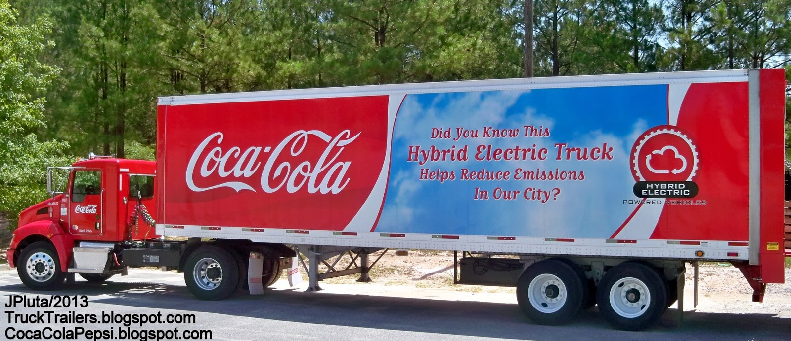
Coca Cola
1.5 billion cokes consumed per day!
Distribution company separate from manufacturing.
Real time data analysis – to find and fix problems like drops in sales i.e. iteration
Notes:
SAB and Coke have both broken through the last mile barrier. What can we learn from them? What have they done? Nearly 50% of people in Africa lack access to critical medicines, yet, you can get a coco-cola nearly anywhere in the world….

Slide 24

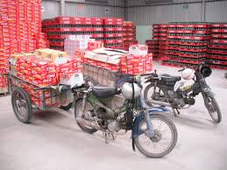
Piggybacking on entrepreneurial networks into rural Africa
Micro-distribution centres
Last Mile consumer
Notes:
SAB and Coke have both broken through the last mile barrier. What can we learn from them? What have they done? Nearly 50% of people in Africa lack access to critical medicines, yet, you can get a coco-cola nearly anywhere in the world….

Slide 25

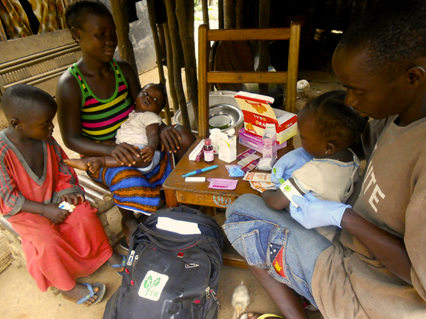
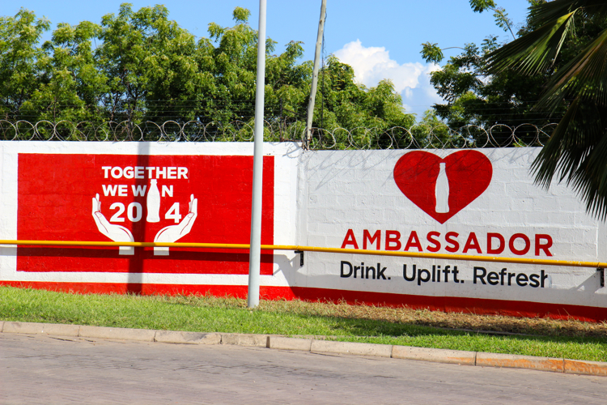
Cola-Cola’s Project Last Mile
PPPs in Tanzania (2010) and Ghana (2013)
USAID
Coco-Cola’s distribution and marketing used to supply rural communities with medicine/vaccines
Forecasting demand, cold-chain management
5500 health care facilities in Tanzania
15600 refrigerators in Ghana
Piggybacking
Local context
Engagement
Notes:
Through PLM, the government agencies managing the procurement and efficient distribution of essential medicines and medical supplies benefit from private sector expertise, learning how to forecast demand for medicines and vaccines, better market the availability of such commodities, and ensure the cold chain equipment is maintained properly for storing certain medicines and vaccines.
Partnering with international aid foundations: important to highlight that this ensures the sustainability of the project, as they each have different strengths and

Slide 26
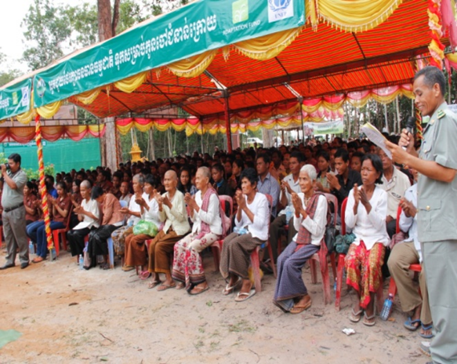
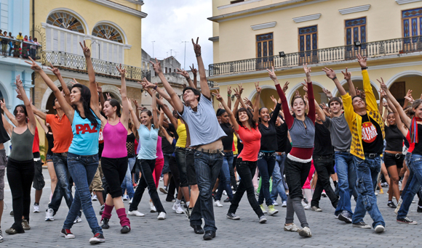
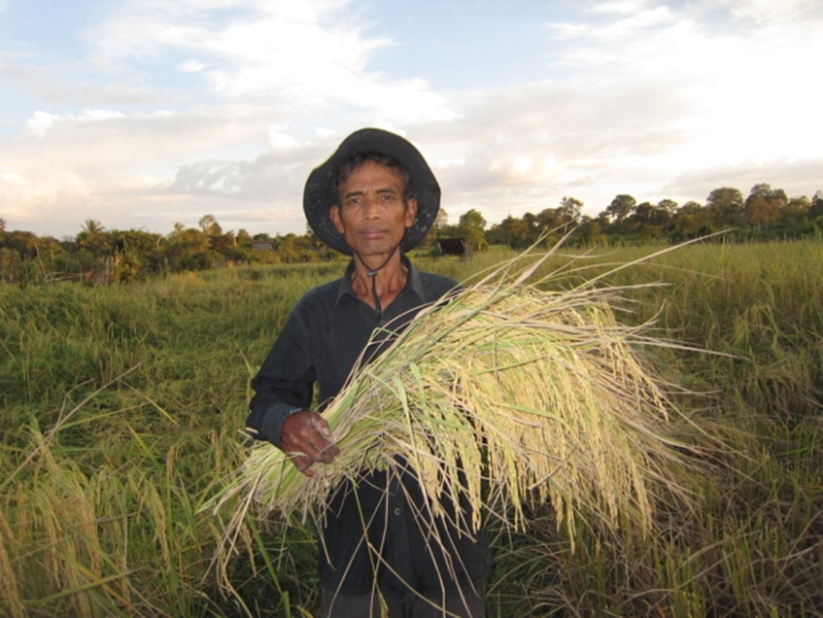
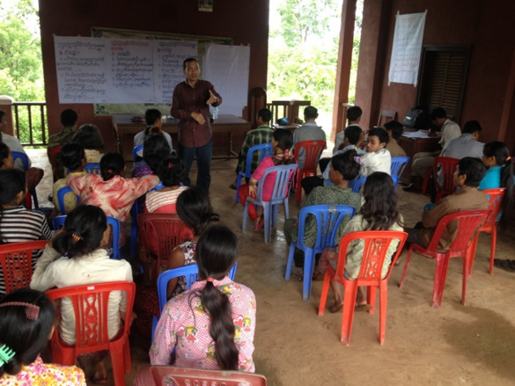
Raising awareness on adaptation in Cambodia
Successful communication channels require
in-depth research
Large screen films in communal spaces
Upgrading of road-rest stops (including signboards) on national roads
Climate change flash mobs
Local context
Engagement
Notes:
.

Slide 27


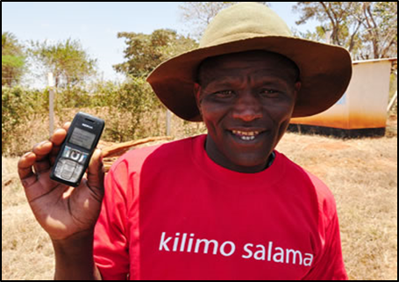
Concluding remarks
Acknowledge intricacy and complexity
Learn from successful operations (including other sectors)
Bundle
Research local context
Engage and train
Use traditional and digital
Develop virtuous cycles
Seek public funds
Piggyback on infrastructure & brands
Iterate
.
Crossing the Last Mile will be an ongoing journey, not a static system.

Slide 28

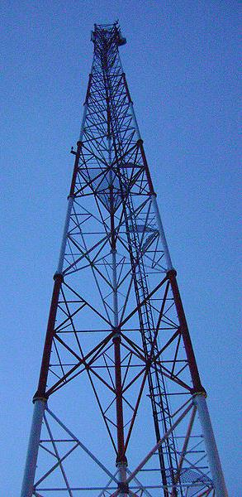
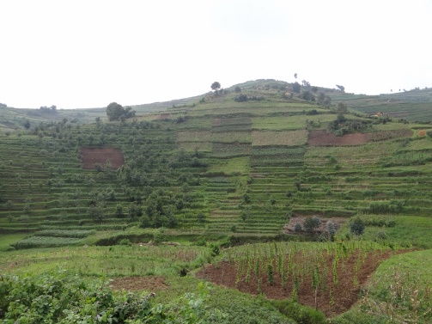
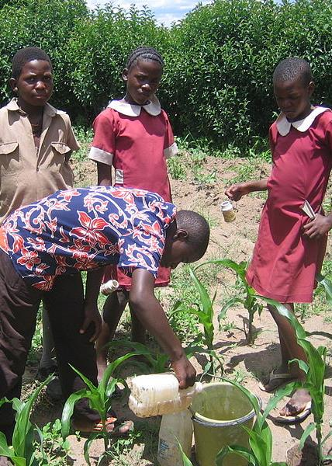
End of presentation
Thank you for your attention.

