Slide 1



CIEWS Communication Strategy in Zambia
Kunda C. Mwila, Managing Director, Just Click (Media & Communications Consultants)

Slide 2
Table of Content
Introduction
Stakeholders Inception Meeting
Strategic Goal and Pillars
Desk Review of Literature
Stakeholders identification and segmentation
Stakeholder Analysis
Message Formulation
Integrated Change Management and Communication Approach
Integrated CIEWS Communication Approach
Communication Strategy Info Flow Chart
Actions & Recommendation

Slide 3
Introduction
Step 1
Stakeholder Inception Meeting
Step 3
Review of Strategies, Policies & Media Content
Step 4
Stakeholder Analysis
Step 5
Implementation
Step 2
Desk Literature Review
Zambia, like other SADC States, has continued to experience an increase in adverse impact of climate change, including climate variability, extreme events and other changes in climate variables over the last several decades.
Extreme weather events, such as floods and droughts, as well as El Niño-induced events have become more frequent and intense, with serious consequences for socio-economic and livelihood activities (MTENR, 2007).
Target Audience Limited access to Mass Comm Channels esp. TV (70% poverty level, illiteracy)
Mobile & Radio Access presenting excellent opportunity (Community Radio)
M & E

Slide 4
Stakeholder Inception Meetings
Activity
Context
Review and approve the proposed methodologies and processes (Roadmap)
Review the old Communication Strategy, if any, or SWOT analysis of how climate change has communicated in the past;
Gather input on the key issues, audiences (primary and secondary) and messages;
Review the proposed success indicators to be adopted for the M & E plan of the strategy
Help in arriving at consensus on other stakeholders, at national and local levels;
Help enlighten the rest of the process about the current issues, messages and approaches in communication at different levels;
Build consensus on the Proposed Goals and Objectives of the new Strategy;
Establish Tools for M & E

Slide 5
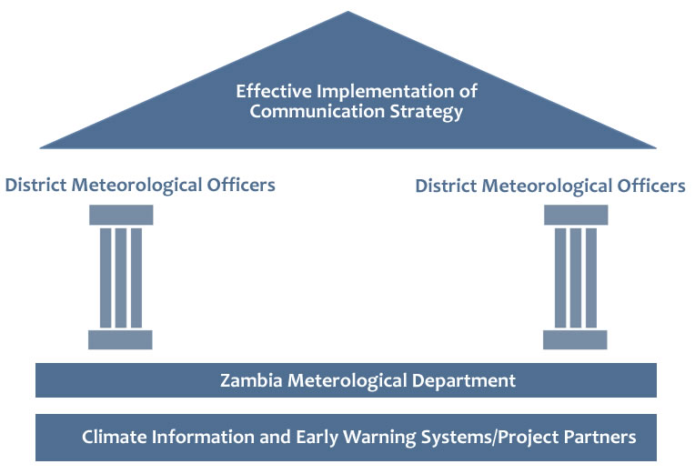
Strategic Goal & Pillars
The ultimate goal of Communications Strategy is to contribute to the successful dissemination of the Climate and Weather information both internally and externally and also help ZMD and its strategic partners achieve its strategic objectives and goals.
The Strategic Pillars for the Communication Strategy will be the ZMD through DMOs, who will be critical conveyors of information from the CIEWS Project Office and ZMD Headquarters to the targeted communities.

Slide 6
Literature Review
Assessment of current and past communications and advocacy strategies, work plans and other strategic documents and plans of CIEWS Project and partners in order to help shape the strategy;
Learn from communications strategies and programmes of other like-minded organizations;
Gather snapshot picture of how the media have covered CIEWS in the past and public perceptions in the media;
Review national and international policies and laws to help in determining the issues, messages and strategies to adopt for the strategy;
Learn more about national and regional CIEWS discourses and trends that need to be factored into the strategy;
Gather snapshot data on capacities (in terms of skills and knowledge) of media houses and media practitioners in reporting on CC and the policy in particular.

Slide 7
Stakeholder Identification & Segmentation
The stakeholder analysis was focused on ZMD, DMMU, Farmers, DACOs, PACOs, MPs, Chiefs the Media and Members of the Public.
Three main segments and clustered further in sub-groups.
Understanding stakeholders is not an easy process, especially as regional linguistic, cultural, media and political variations create nuances from region to region for both end-users (communities and farmers) and policy makers.
End Users | Actors | Owners/ Partners
SS-Farmers | DMOs | ZMD
LS-Farmers | Traditional Leaders | DMMU
Local Communities | DACOs/PACOs | DWA
Private Sectors | Policy Makers (MPs & GRZ Officials) | WRMA
NGOs | Media | MoA, MoL, MoH
 | Interest Groups | INCCS, CSO

Slide 8
Stakeholder Analysis
Activity
Context
SWOT of key stakeholders
Document existing communication and advocacy activities of major stakeholders (NGOs, CBOs, chiefdoms, other ministries or departments, private sectors, etc.) and local communities in purposively selected groups from urban and rural settings.
Establish the real information needs and issues of the stakeholders, communities and the general public across the three ecological zones of the country; ;
Review the proposed success indicators to be adopted for the M & E plan of the strategy
Establish Strengths, Weaknesses, Opportunities and Threats
This is necessary to ensure that the strategy does not exist in isolation but in complimentarily with other initiatives;
Gather public and stakeholder perceptions about current communication and advocacy approaches, issues and players; ;
Build consensus on the Proposed Goal and Objectives of the new Strategy;
Establish Tools for M & E

Slide 9
Message Formulation
Key Messages
The messages to specific stakeholders vary by segment and by industry. i.e. A farmer doesn’t care if energy production levels will rise nationally or if he’s getting information from an AWS.
Plant Early Maturing Crops for farmers in drought areas
Avoid building houses in floods prone areas.
Always check weather bulletin or consult your MET Officer for weather conditions

Slide 10
Integrated Change Management and Communication Approach
Gather Input
Develop Strategy
Plan
Execute
Input is gathered from available means to form the basis for change management and communications strategy
Leading practice change management and communications practices adapted to meet the CIEWS/ZMD Change Management efforts
The strategies are used to develop integrated set of CIEWS Change & Communication activities
Activities are executed and the plans are updated based on feedback. Monitor to ensure timely execution
Feedback Loop
Stakeholder Mapping
Analysis to define stakeholders and their needs and concerns relating to the project; identifies the level of impact the project will have on the stakeholders and the key messages to address the needs of stakeholders, i.e. ZMD, DMMIU, MAL. See details on stakeholder analysis.
Change Management Strategy
The Change Management Strategy outlines the approach, guiding principles, and types of activities used to support the CIEWS PROJECT.
Change Management Plan
The Change Management plan is a living document outlining recommended change management activities by timeframe, audience, key drivers and outcomes, and recommended interventions.
Integrated Plan and Execution
The change management and communications plans are integrated into an actionable plan which will effectively and efficiently implement the change management and communication strategies
Stakeholder Mapping
Analysis to define stakeholders and their needs and concerns relating to the project; identifies the level of impact the project will have on the stakeholders and the key messages to address the needs of stakeholders, i.e. ZMD, DMMIU, MAL. See details on stakeholder analysis.
Communication Strategy
The Communication Strategy outlines the approach and communication principles used for planning communication.
Communication Plan
The communication plan is a living document outlining communications activities by timeframe, audience, key messages, recommended vehicles, and development/sender responsibilities
Stakeholder Discussions
Surv
Feedback Loop

Slide 11
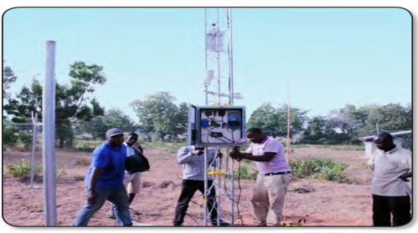

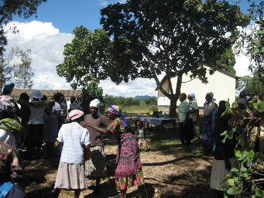

Integrated CIEWS Communication Approach
Climate/Weather Information
ZMD generates and disseminates Climate Information for distribution to DMMU and other stakeholders over various media platform.
Early Warning Systems
DMMU develops Early Warning Information to be distributed using different systems and platforms including SMS, Traditional Media, Social Networks, etc.
Media Channels
Climate Information to stakeholders on various media platforms such as direct sharing information with DMMU, Brochures, Radio, TV, etc
Figure shows an Integrated Communication Approach for Climate Information and Early Warning Systems with feedback provision from stakeholders

Slide 12
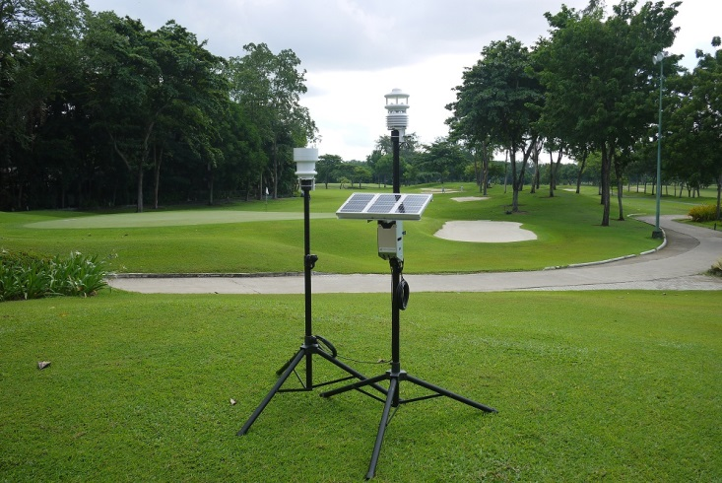
Communication Strategy Info Flow Chart
Climate & Weather Info generated by ZMD feeds into Early Warning Systems championed by DMMU & other agencies
ZMD HQ
ZMD Regional Offices
DMOs
Community based partners, i.e Chiefs, Farmers Associations, NGOs
Stakeholders at National and Regional Levels, i.e. DMMU, DWA, WRMA, MAL, MOH, CSO, etc
District level partners, i.e DMMU, DACO, NGOs, etc

Slide 13
Actions & Recommendations
Short-Term | Medium Term | Long-term
Seasonal Weather Forecast Forums | Community Engagement Training for Met Officers/ZMD Team Building & Bonding | CIEWS Kiosks/Info Centers & Libraries
CIEWS Brochures & Video Documentary in vernacular languages | CIEWS Branded Materials | Enhancing Climate, Weather & Early warning training in Mass Media and Journalism Schools
Chiefs Awareness Workshop | Media Training for selected reporters from Electronic and Print Media Houses | Sector Specific Weather and Climate Content and Products.
MPs Awareness Workshop | Weather and Climate Information Training for Selected Chiefs | PPP in CIEWS Gathering and Dissemination.
Monthly media briefing | Integration of the Indigenous Knowledge into ZMD Weather and Climate Information | Employment of the Communication Officer
CIEWS SMS System /Social Media apps | Community Based Weather and Climate Information Musical Concerts and Drama | Continuous Capacity Building of Met Officers

Slide 14
Litumezi!
Twalumba!
Zikomo
Thank you!
E-mail: trinity.mwila@gmail.com,

