Slide 1
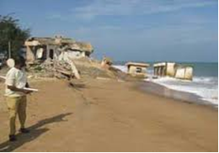
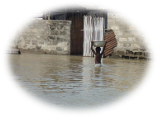
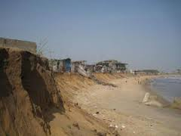
UNDP CIRDA Workshop, 15-17 March 2016, Livingstone, Zambia
Benin Climate Information/Early Warning System
(CI/EWS) Project
The Standard Operating Protocol for normalization of hydroclimate alert communication and diffusion
Dr-Ing. Arnaud ZANNOU
Benin CI/EWS Project Director
Notes:
Instructions: Complete items in red italics

Slide 2
What is the problem ?
In 2010, Benin was facing the most flooding disaster of his history.
46 deaths and around 680,000 affected persons, losses and damages up to $260 millions US, and negative socio-economic impact estimated to 0.8 regress on GDP.
After this disaster management, we observe that one of the weakness point of our institutional disaster management framework is a very bad crisis communication management.
So, by considering that alert is the first step of crisis communication mechanism, we begin our CI/EWS project by solving the critical issue.
Notes:
This should be a list of agencies (see previous slide) followed by a (brief) listing of the major contributions of services, technology, or other resources they have provided or will provide to the CiRDA program. Don’t try to list everything, just the major or unique resources – people, data and information products, funds, equipment, facilities, etc...

Slide 3
Questions to answer ?
Who (actor) has a responsibility in the communication of alert message to community.
From where each of these actors can get the alert message
To whom each actor must transmit alert message?
How many time must use each actor to transmit the alert message to following actor?
Notes:
This should be a list of agencies (see previous slide) followed by a (brief) listing of the major contributions of services, technology, or other resources they have provided or will provide to the CiRDA program. Don’t try to list everything, just the major or unique resources – people, data and information products, funds, equipment, facilities, etc...

Slide 4
How to proceed ?
We contract a private Cabinet 2SC specialized in the crisis and disaster management in Benin: ToR = develop the SOP for normalization of alert communication and diffusion in case of hydroclimate disaster in Benin.
2SC organized meetings with around 20 institutions involved in disaster management in Benin, and with the frequently affected populations of 25 districts (33% of Benin districts, chosed by consideration of our 5 risks and the socio-cultural realities of each community respectively).
After information compilation, 2SC draft and we adopt the SOP chart.
Notes:
This should be a list of agencies (see previous slide) followed by a (brief) listing of the major contributions of services, technology, or other resources they have provided or will provide to the CiRDA program. Don’t try to list everything, just the major or unique resources – people, data and information products, funds, equipment, facilities, etc...

Slide 5
How to produce alert message ?
UNDP-GEF (Financial and Technical Support)
Hydrological Department
Hydro Data + River flooding Warning
Meteo Department
Meteo data + Rain Flooding, Drought and Severe wind warning
University
Modelling and scientific expertise on all hydro-climate risks
WARNING
Disaster Manag.Agency
C I
P A
Oceanography Institute
Oceano data + coastal erosion and sea level rising warning
Final Beneficiaries = Population
Notes:
This should be a list of agencies (see previous slide) followed by a (brief) listing of the major contributions of services, technology, or other resources they have provided or will provide to the CiRDA program. Don’t try to list everything, just the major or unique resources – people, data and information products, funds, equipment, facilities, etc...

Slide 6
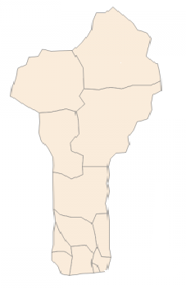

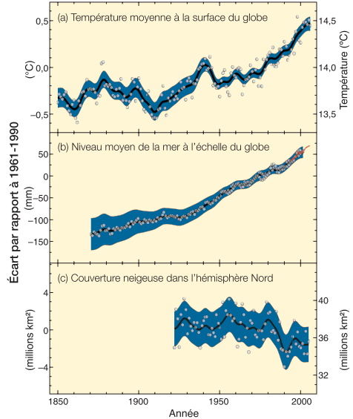
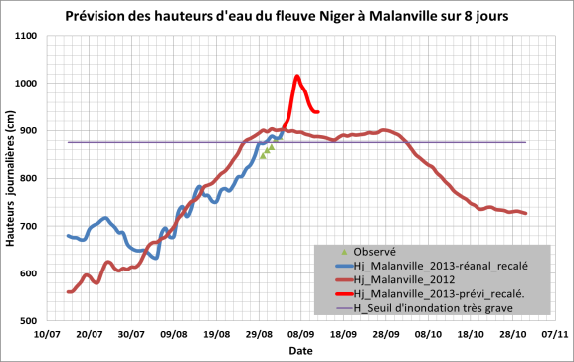
Flood warning !!!
Niger
Technical Design and Operating of Early Warning System
Burkina Faso
Legend
Drought warning !!!
Ground Rain Observations (20)
River or Lake Observations (25)
Sea parameters observations (5)
National Centre for Forecasting and Warning
Severe Wind warning !!!
Togo
Nigeria
Flodd warinng
!!!
Dangerous sea warning
Atlantic Ocean

Slide 7
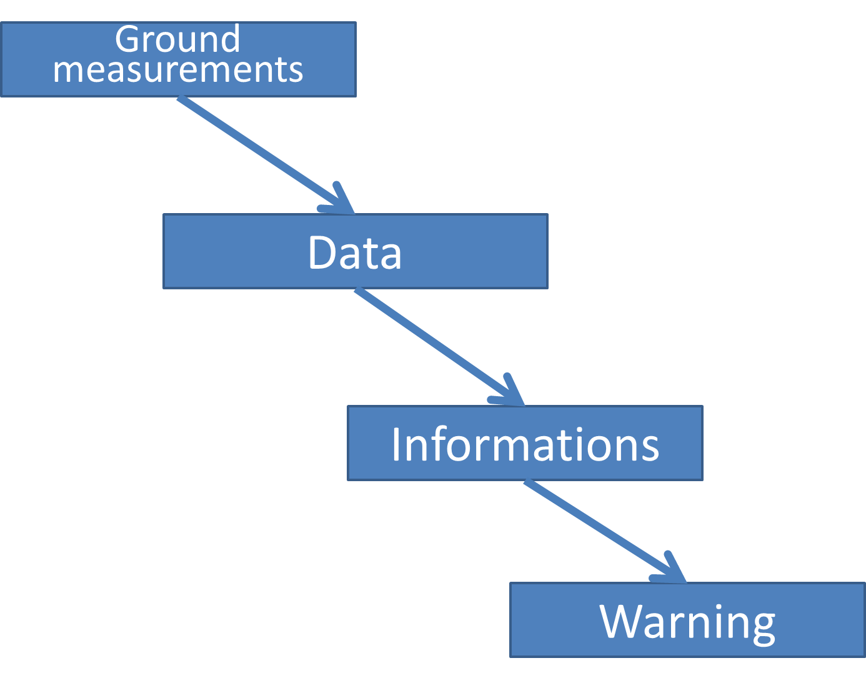
Information system of Early Warning System in Benin
WARNING LEVELS
 | GREEN : Monitoring (by automatic stations)
 | YELLOW : Vigilance (by forecasters)
 | ORANGE : Alert (by disaster managers)
 | RED : Crisis management (all stakeholders)

Slide 8



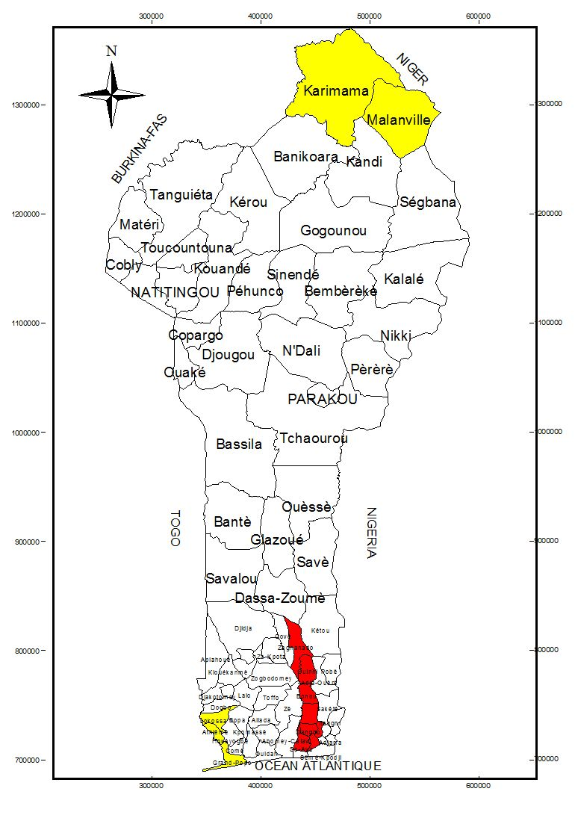





PROJET
SAP-Bénin
Information Climatique et Alerte Précoce
CARTE NATIONALE DE VIGILANCE
BULLETIN D’ALERTE INONDATION
du mardi 30 septembre 2014 à 12h00 min
MESSAGE D’ALERTE ROUGE
Niveaux d’eau relevés ce jour: sur le fleuve Niger 711 cm à Malanville et sur le fleuve Ouémé, 455 cm à Bétérou; 660 cm à Savè; 886 cm à Zangnanado; 860 cm à Bonou; 477 cm à Adjohoun et 145 cm à Agbanankin.
Ainsi, le niveau d’alerte reste toujours JAUNE sur le bassin béninois du Niger (Malanville, Karimama), et sur le bassin du Mono à Grand-Popo. L’alerte est maintenue ROUGE dans la basse Vallée de l’Ouémé.
Pour les 4 prochains jours, l’alerte demeurerait ROUGE dans la basse Vallée de l’Ouémé.
DNM
Niveau VERT | Situation Normale
Niveau JAUNE | Situation à surveiller
Niveau ORANGE | Risque moyen de catastrophe
Niveau ROUGE | Risque élevé de catastrophe
CONSIGNES A APPLIQUER:
Se référer à l’Agence Nationale de Protection Civile (ANPC):
Tel: 95.86.13.13//97.76.12.80
Email: anpcbenin@yahoo.com
Situation nationale des niveaux d’alerte aux inondations
au 01-10-2014
Elaborée par :
Cellule Inter-Institutionnelle de Prévision et d’Alerte du Projet SAP-Bénin (DG-Eau, DNM, ASECNA, IRHOB, INE, PNUD)
Contacts:
Arnaud ZANNOU (97.60.38.05) &
Martial DOSSOU (97.37.13.58)
Email: sapbenin@gmail.com

Slide 9

Chart of SOP:
Standard Operating Protocol for warning messages communication and diffusion in case of hydroclimate disaster in Bénin

Slide 10
Success and challenges…
A real comprehensive framework legally adopted by Government : each actor knows his role, and also knows and respects the role of others actors involved!
A veritable interaction between several institutions!
Each actor don’t need to refer first to his superior before give alert message to following actor in chart!
Each actor gives credibility to alert message he receive!
Notes:
This should be a list of agencies (see previous slide) followed by a (brief) listing of the major contributions of services, technology, or other resources they have provided or will provide to the CiRDA program. Don’t try to list everything, just the major or unique resources – people, data and information products, funds, equipment, facilities, etc...

Slide 11
Challenges and future extension actions…
How to support in sustainable way the payement requested by media before taking action?
We work to set up PPP with mobile companies in order to disseminate SMS to people cell phones in areas affected.
Also alert dissemination via social media app (Facebook, Twitter) are considering in our approach.
Notes:
This should be a list of agencies (see previous slide) followed by a (brief) listing of the major contributions of services, technology, or other resources they have provided or will provide to the CiRDA program. Don’t try to list everything, just the major or unique resources – people, data and information products, funds, equipment, facilities, etc...

Slide 12
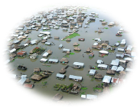
Thank for your attention !!!
Questions ???
Notes:
This should be a list of agencies (see previous slide) followed by a (brief) listing of the major contributions of services, technology, or other resources they have provided or will provide to the CiRDA program. Don’t try to list everything, just the major or unique resources – people, data and information products, funds, equipment, facilities, etc...

