Slide 1




STRENGTHENING OF CLIMATE CHANGE EARLY WARNING SYSTEMS
STATUS REPORT
Lamin Mai Touray, Project Director
Ousman Jarjusey, Project Coordinator
Bubu Pateh Jallow, Chief Technical Adviser
Department of Water Resources
7 Marina Parade, Banjul

Slide 2
Four Expected Outcomes of Project
The Gambia National Meteorological Services is supported in its transition to becoming a financially sustainable Meteorological Agency (UNEP)
Hydro-meteorological infrastructure is upgraded / installed and maintained that will cover the full needs for 'optimal performance of EWS' as identified by recent needs assessment reports in the Gambia (UNDP)
A critical mass of skilled human resources is able to operate the Gambia Early Warning System and perform medium and long-term climate adaptation planning beyond the project (UNEP)
Efficient and effective use of hydro-meteorological and environmental information for making early warnings and long-term development plans (UNEP)

Slide 3
Outcome 2: Hydro-meteorological infrastructure is upgraded / installed and maintained that will cover the full needs for 'optimal performance of EWS' as identified by recent needs assessment reports in the Gambia (UNDP)
Office of the UNDP Resident Representative has procured and handed over to Government many and various equipment ranging from Automatic Weather Stations to Computers 2 Boats and a Vehicle.
These will be distributed to stakeholder institutions within the Department of Water Resources

Slide 4
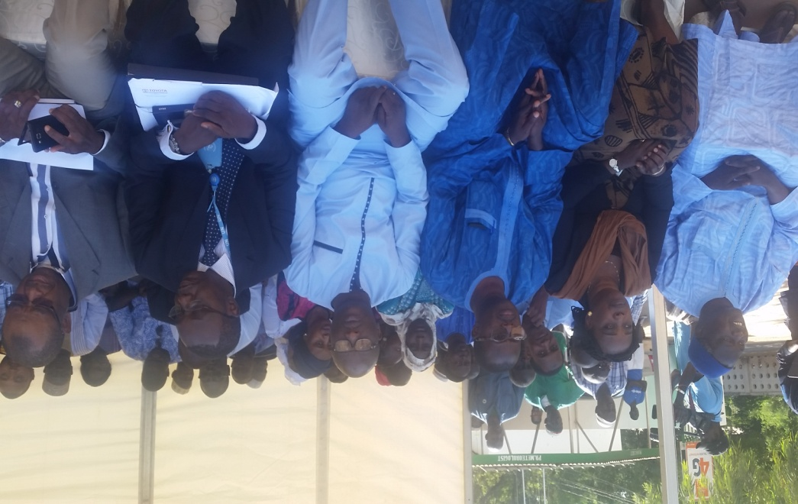
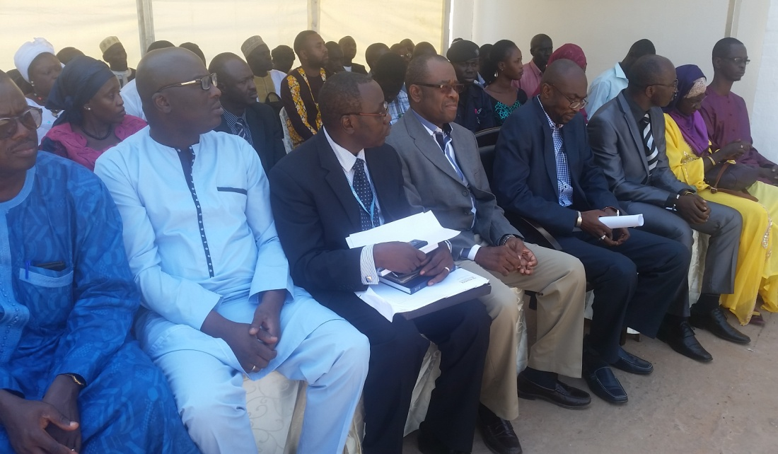
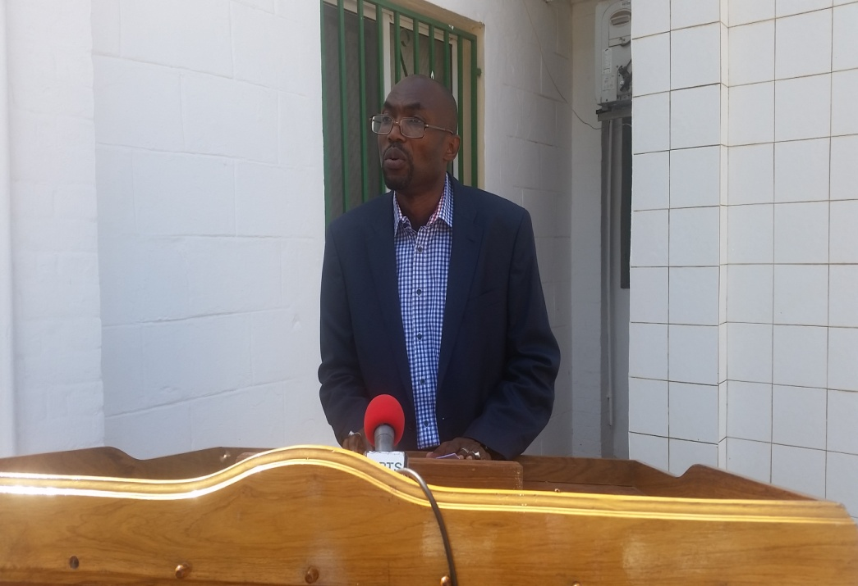
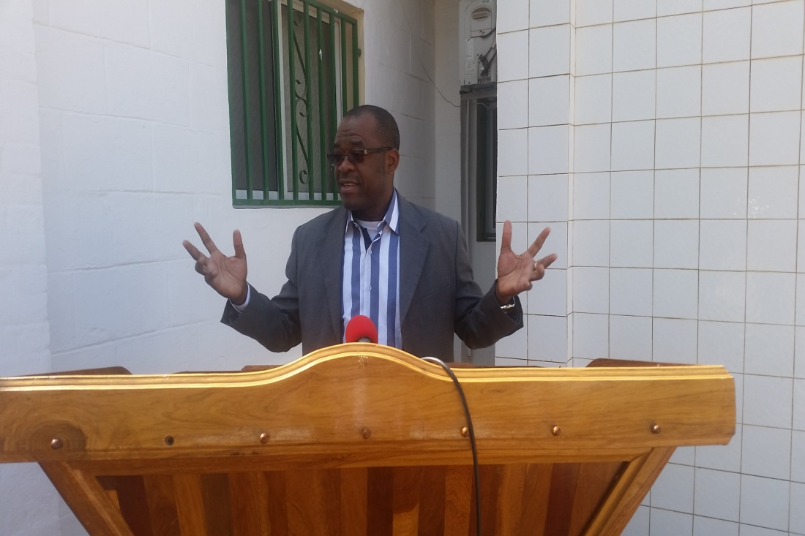
Handing over of equipment to Government
Hon. Minister gracing the Handing Over Ceremony
Representative of UNDP RR gracing the Handing Over Ceremony

Slide 5
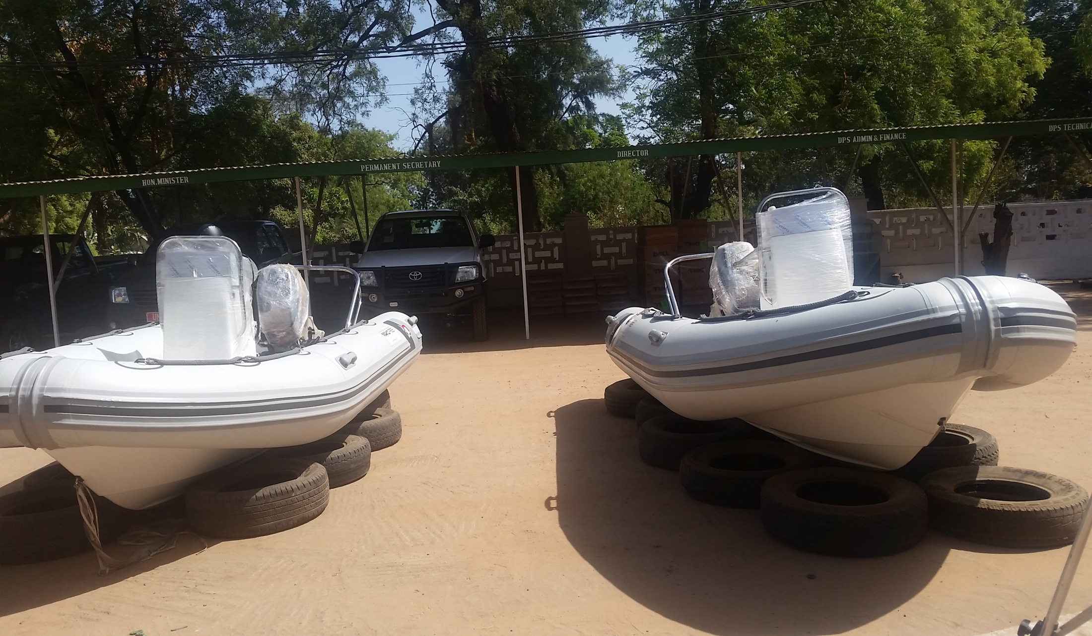
Some of the Equipment procured and Handed Over to Government by UNDP
Vehicle and Boxes containing Computer Equipment in the Background

Slide 6
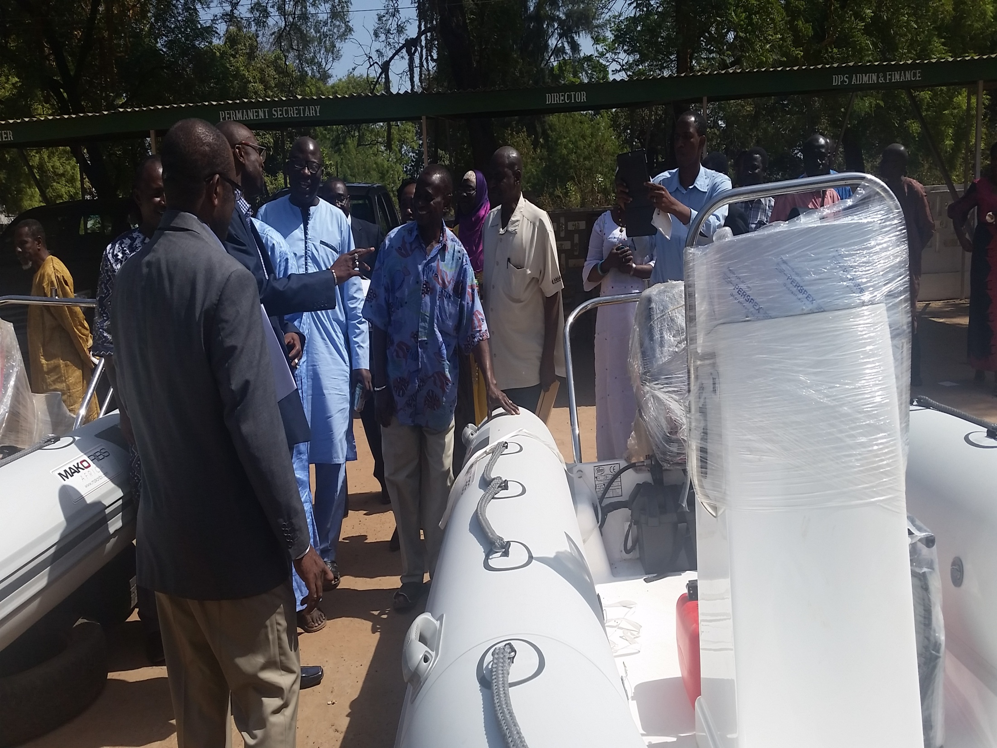
Boats for Water Quality Sampling and Hydrological Measurements along the River Gambia

Slide 7
Gambia started in 2011 under Phase I
OUTCOME 3:
A critical mass of skilled human resources is able to operate the Gambia Early Warning System and perform medium and long-term climate adaptation planning beyond the project (UNEP)
OUTCOME 4:
Efficient and effective use of hydro-meteorological and environmental information for making early warnings and long-term development plans (UNEP)

Slide 8
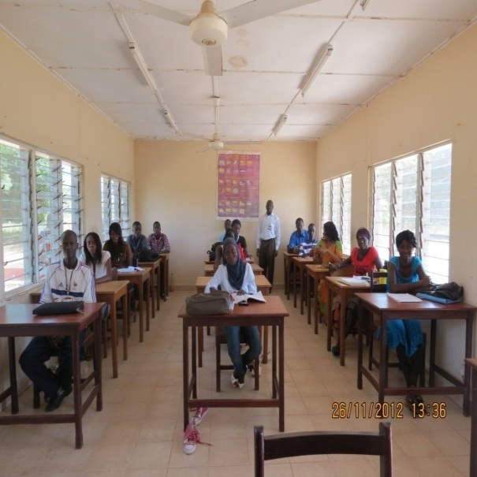
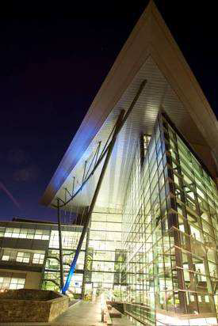
Enhancing Human Capacity for Effective Early Warning System (OUTCOME 3)
  35 Junior Met. And Hydro Technicians trained at the Water Resources Training School, Banjul
  1 Senior Hydrological Technician Trained in Barbados
  2 Instrument Technicians trained and certificated in Nigeria
  3 Meteorologists trained at the UK Met Office
  1 Meteorologist trained in FUTA, Akure, Nigeria
  7 Middle Level Met. Technicians trained in Oshodi, Nigeria
  6 Senior Level Technicians are currently on training in Oshodi Nigeria

Slide 9
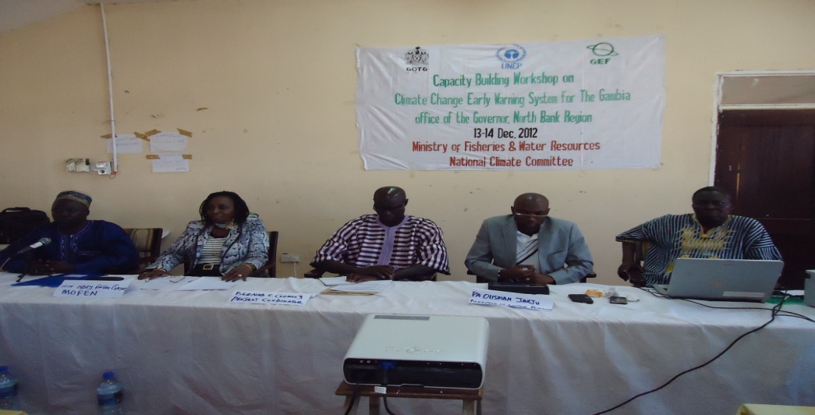
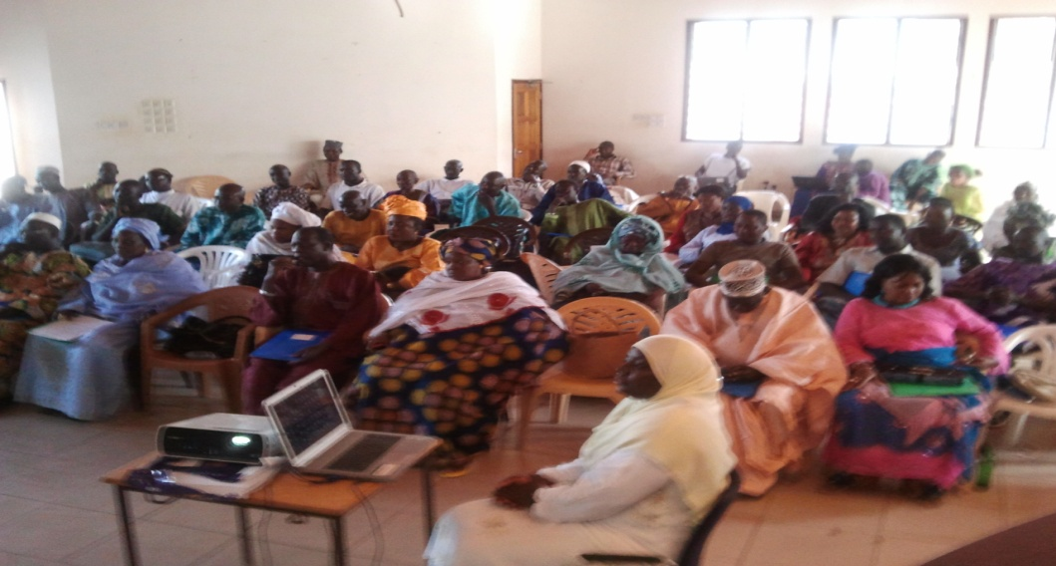
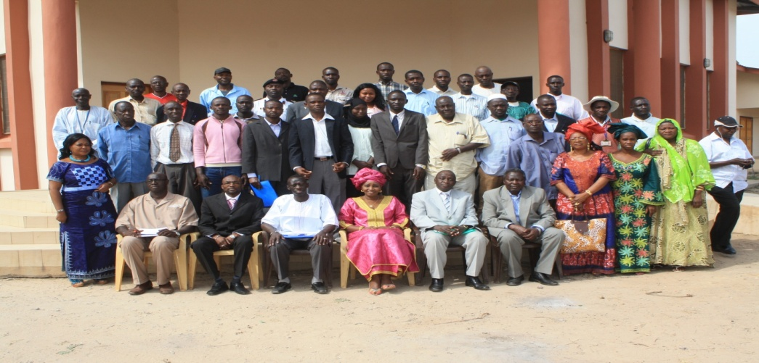
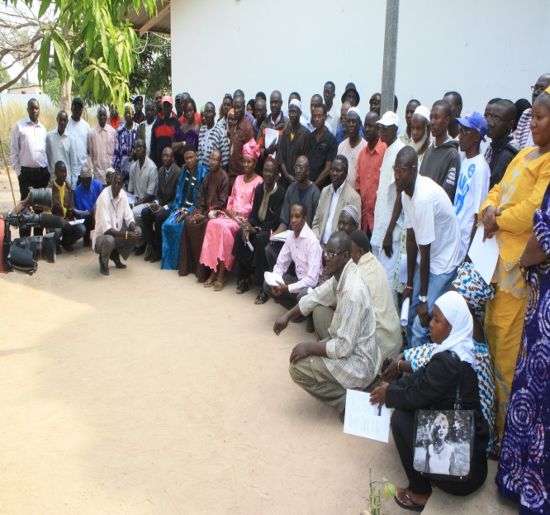
In 2013 and 2014 over 200 persons were sensitized on climate change and specifically on climate change early warning system
BANJUL CITY COUNCIL
NORTH BANK REGION
KANINIFING MUNICIPAL COUNCIL
WEST COAST REGION

Slide 10
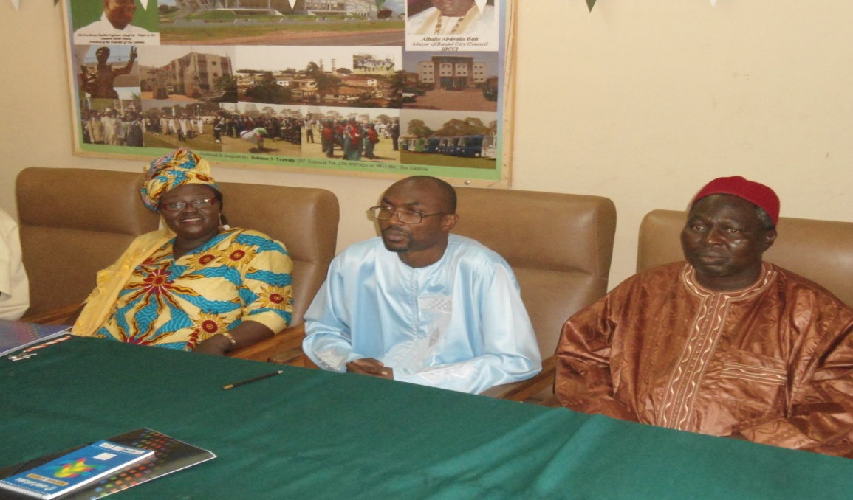
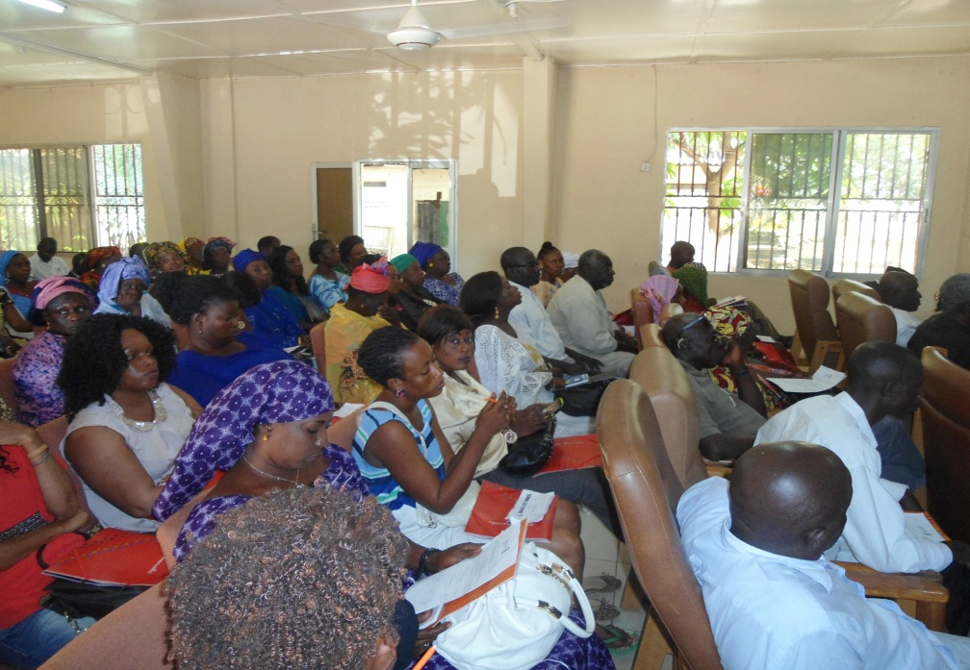
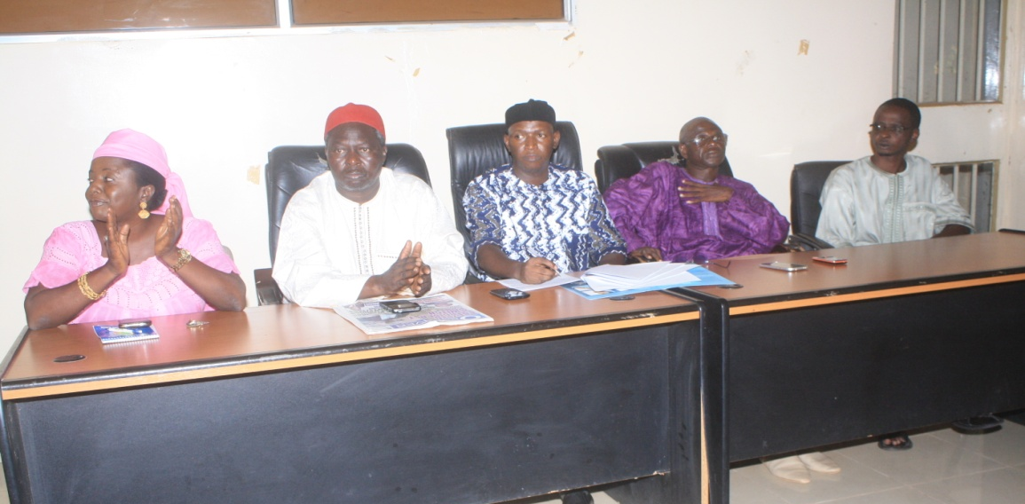
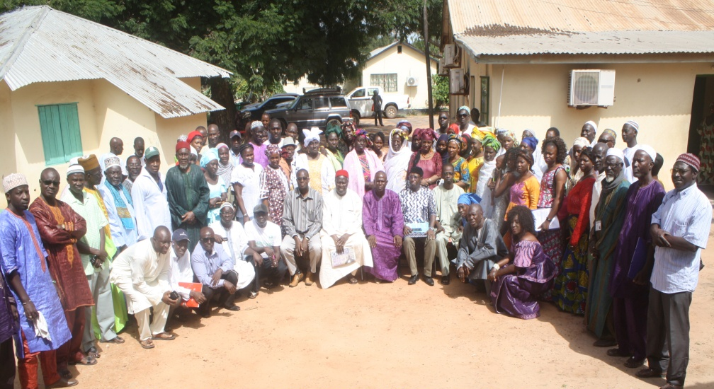
In 2015 about 1,135 persons were sensitized on climate change and specifically on climate change early warning system

Slide 11
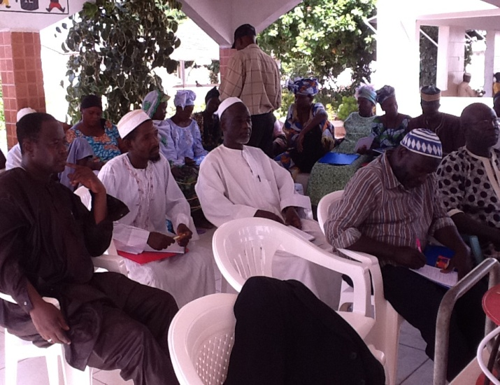
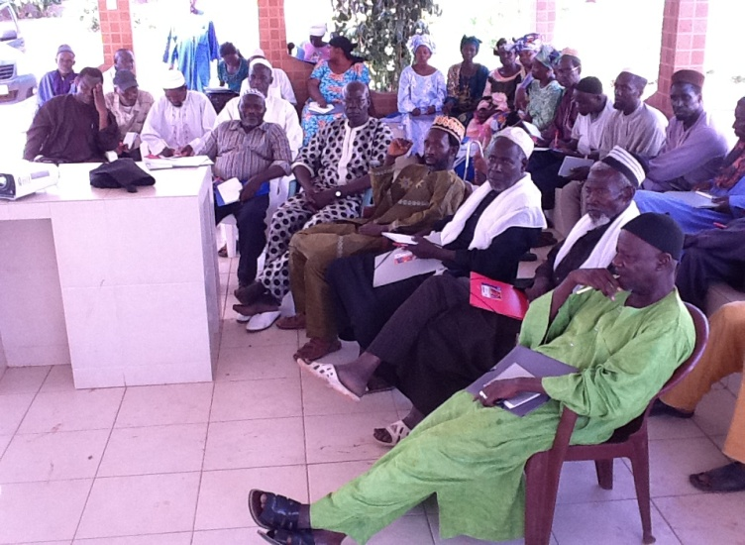
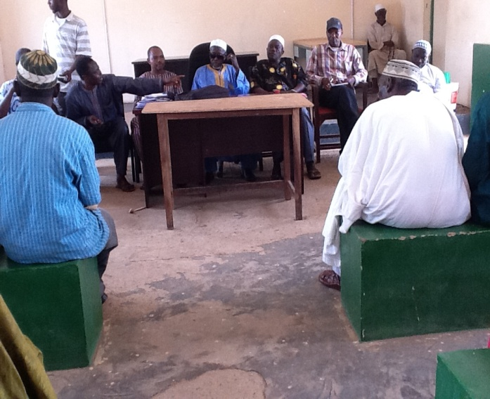
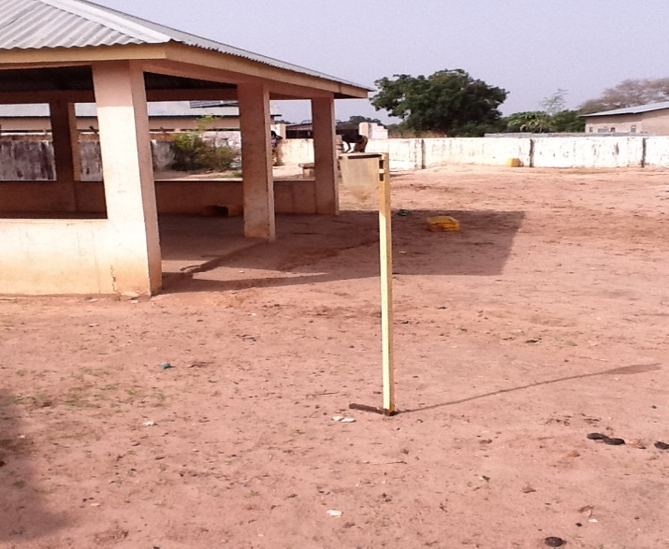
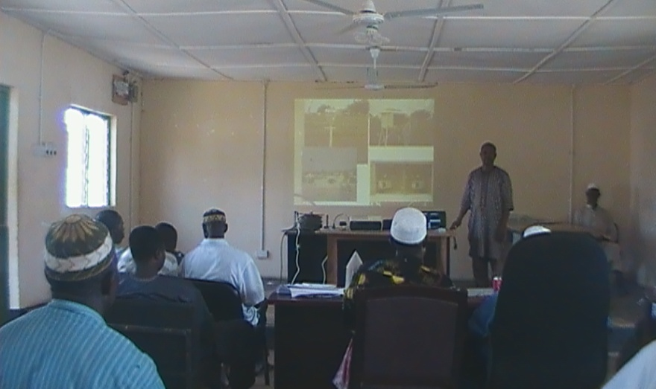
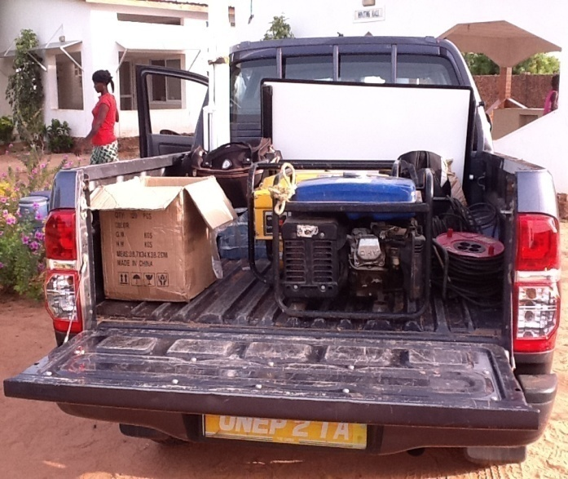
By 2014 about 150 Farmers and other stakeholders were trained on agro-meteorological practices using an International Agro-meteorological Consultant from Mali in collaboration with a National Team;

Slide 12
Efficient and effective use of hydro-meteorological and environmental information for making early warnings and long-term development plans (UNEP)
Identifying Providers and Users
Determining User Needs
Tailoring and developing climate change early warning products based on user needs
Identifying and determining most appropriate modes of communication of early warning products
Communicating early warning products
Employing Feedback mechanism for future improvement
Translate all these into a Communication Strategy or Protocol

Slide 13
Major Users Identified and Needs
Communities (Farmers, Fisher Folks, Herders, Extension Services and Agents, etc);
Civil Society including Community Based Organizations and other relevant Groupings
Public and Private Sector Institutions and personnel
Media Institutions and Agents (Journalists, Traditional Communicators, National Radio and TV services, Community Radios, etc.)
Climate and Weather Warnings, Alerts, Forecasts (nowcasts, forecasts, season and long-range predictions)

Slide 14
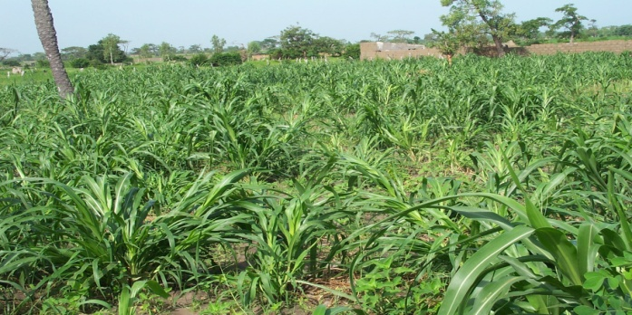
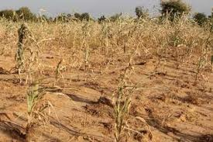
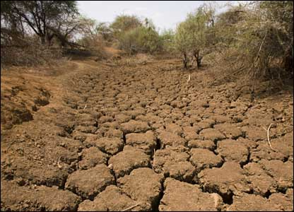
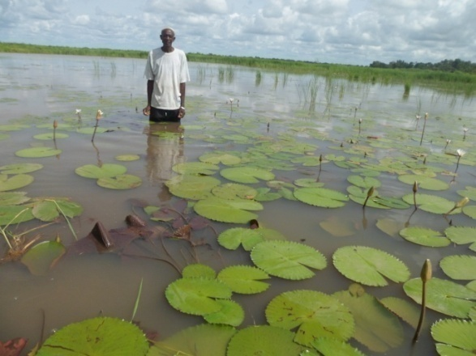
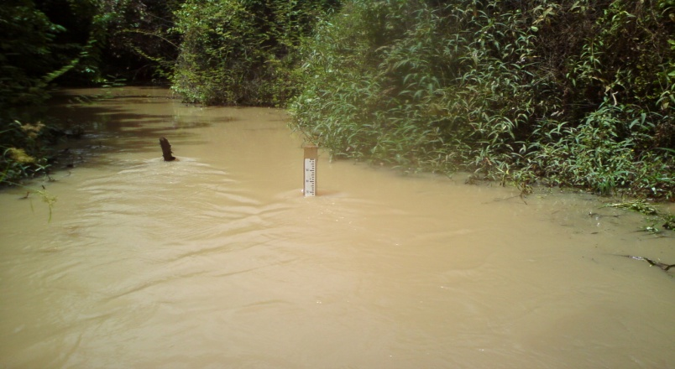
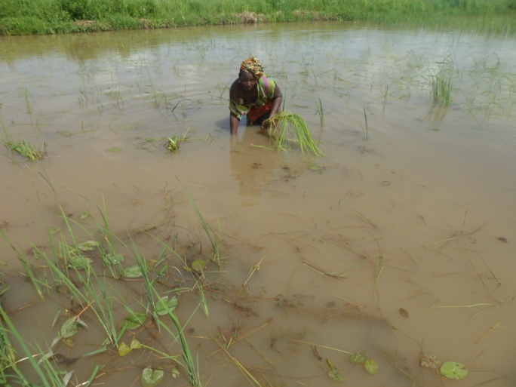
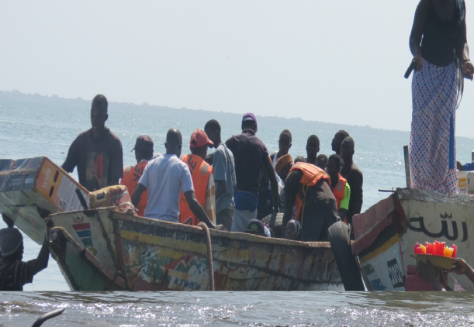
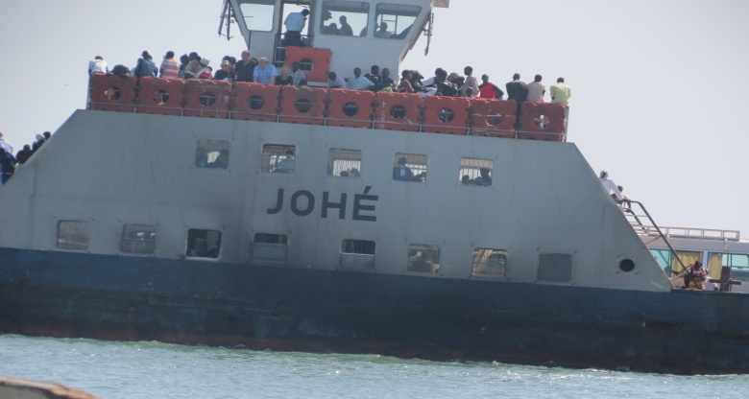
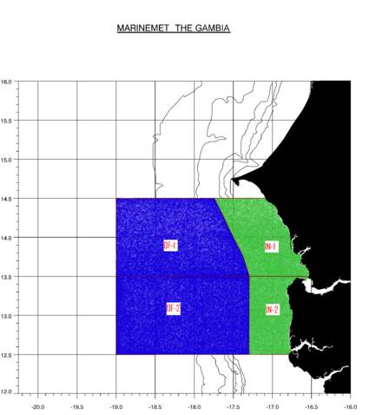
Early Warning User Needs and Products
Drought Prediction
Flood Forecasts
Marine Forecasts

Slide 15
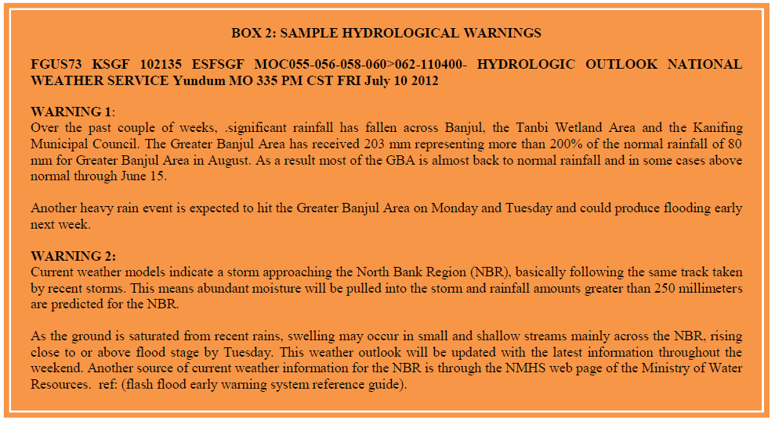
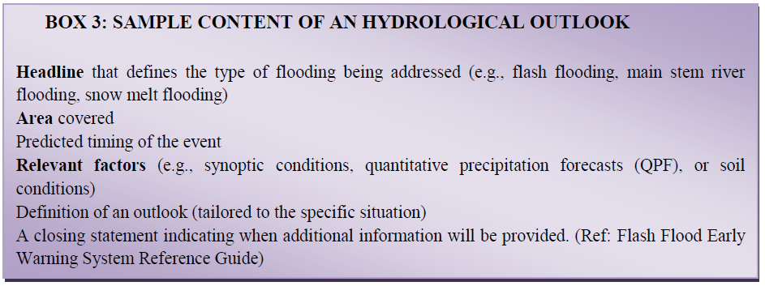
Early Warning User Needs and Products
HYDROLOGICAL WARNING
HYDROLOGICAL OUTLOOK

Slide 16
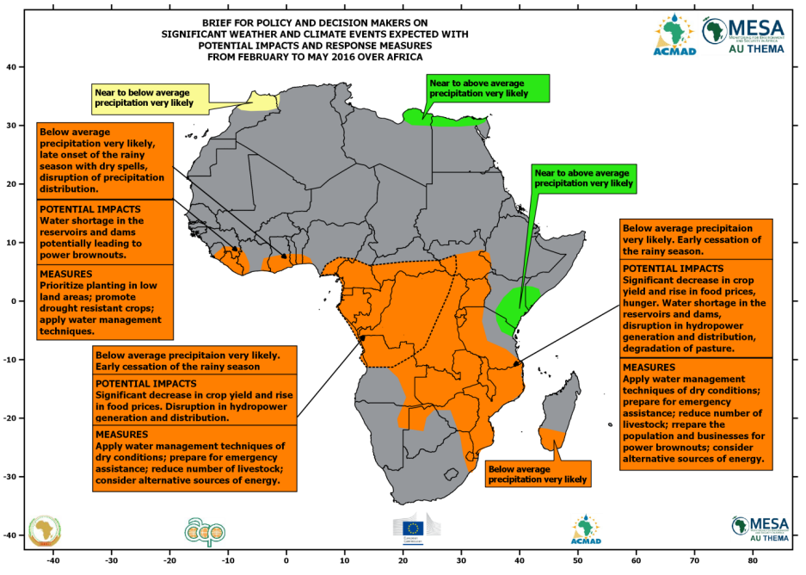
Seasonal Climate Predictions

Slide 17
Modes of Communication of Early Warning Information to Users
Television Broadcasts
National and Community Radio Broadcasts
Print Media (Daily Observer, The Point, The Standard, etc)
Ministerial and Agency Media and information units (Health, Agriculture, Environment, Women’s Bureau, Information Department, etc.);
GSM Companies (Qcell, GAMCEL, AfriCell, etc,)
Websites (MoECCFWW) and internet facilities at partner institutions
MDFTs and TACs
Radio Listening Groups
Traditional Communicators and Theater Groups
Newsletters, Policy Briefs, Posters, Billboards, etc.

Slide 18
Also for the Communication Strategy
Sign and Implement Agreements between the PMU and Community Radios for the continuous reception of climate information from the Weather Forecast Office and subsequent broadcast to communities in English and Local Languages;
Establish Radio Listening Groups consisting of about 15 persons for reception, discussion and dissemination of weather and climate information;
Translate Meteorological Terms into local languages in collaboration the Ministry of Education, the Gambia Radio and Television Services, Media Agents and stakeholders in the Projects sites

Slide 19
Also for the Communication Strategy
Train representatives of Media Houses on climate change and climate change reporting;
Engaged and sensitized representatives of the Private Sector on climate change including business risks and opportunities related to climate change;
Transform the climate and hydrological data base and management system at the Department of Water Resources and develop a METADATA System

Slide 20
THANK YOU FOR YOUR ATTENTION

