Slide 1
LOGICAL FRAMEWORK – Activities design
Ms. Lucy Naydenova
Project Manager NAP-GSP support to LDCs
UN Environment

Slide 2
Terminology Refresher
Component - label for a cluster of measures to achieve the vision
Outcome - what must be in place?
Outputs - interventions/deliverables
Activities – steps to take

Slide 3
1. Resilience strengthening at community level
1.1 Enhanced capacity of Community X to mitigate climate change risks
1.1.1 Awareness-raising campaign conducted
1.1.1.1 Develop one leaflet…
1.1.1.2 Deliver 3 radio-transmissions...
1.1.2 Early-warning App developed and disseminated
1.1.2.1 Develop an Early-Warning App connected to local weather stations..
1.1.2.2 Install 10 billboards along main roads to promote App..

Slide 4
Task Allocation, Partners - Deadlines
1.1.1.1 Develop one leaflet
Task allocation:
Communication advisor, national consultant
Partners:
Ministry of Education
Deadline:
Q4 Year 1

Slide 5
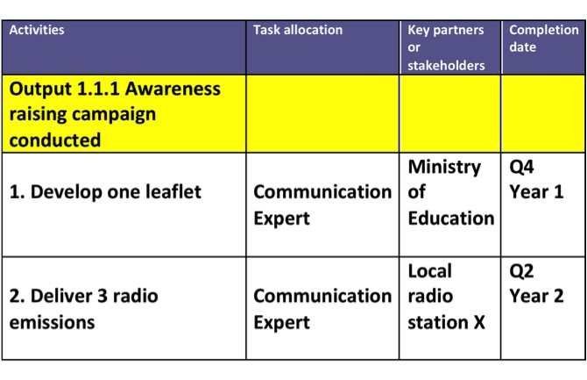
Example

